Slide 1
Evaluating the Accuracy of HawkEye Ocean Color Imager: Comparative Study of Satellite Derived and In Situ Measurements
Mitch Torkelson

Slide 2
Outline
Introduction
Monitoring Coastal Ecosystems
SeaHawk/HawkEye CubeSat Mission
Objectives
Materials and Methods
Preliminary Findings

Slide 3
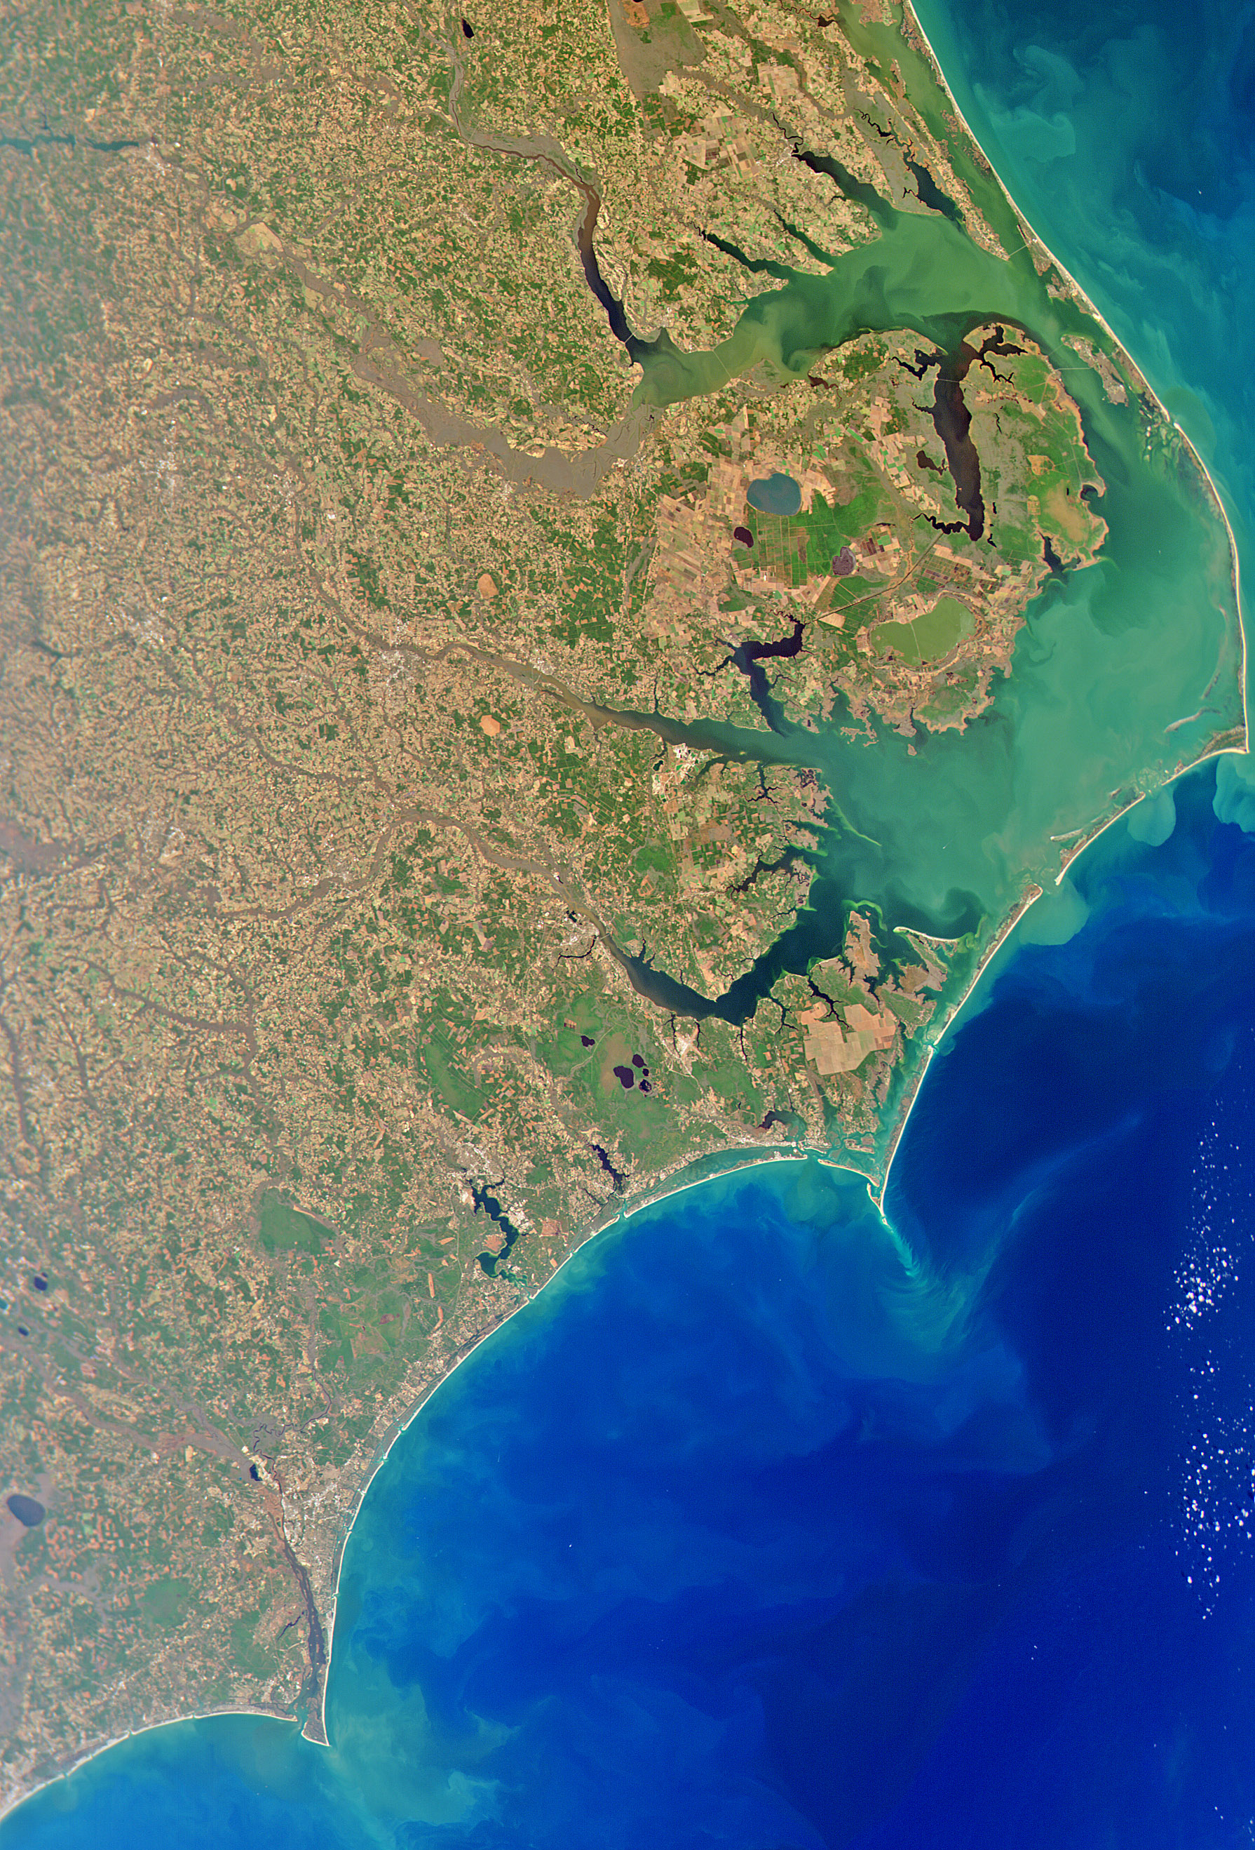
Monitoring Coastal Ecosystems
Significance of Coastal and Estuarine Ecosystems
Covers only 7% of ocean but accounts for 15% of marine primary production
$2.5 trillion annual value from fisheries, aquaculture, and tourism
Marine Monitoring with Ocean Color Remote Sensing
Estimates water quality using visible and NIR portions of the electromagnetic spectrum.
Crucial for estimating global phytoplankton concentrations and informs about chlorophyll a levels and primary productivity.
Challenges in Coastal Remote Sensing
Complexities due to adjacent landmass reflections, particulate matter, and water column heterogeneity.
Specialized methods required for accurate coastal monitoring.
Notes:
Coastal and estuarine ecosystems hold a unique ecological and economic position in our world. Despite only covering 7% of the oceanic area, they contribute 15% of marine primary production. This productivity underpins their economic value, which adds $2.5 trillion annually to the global economy, from sectors such as fisheries, tourism, aquaculture, and the protection offered by natural coastal infrastructure like dune systems.
To monitor and manage these ecosystems effectively, Ocean Color Remote Sensors (OCRS) are indispensable. These sensors capitalize on the relationship between the color of the ocean, which varies with the intensity and spectral distribution of light reflected off the water’s surface, and the biogeochemical processes occurring within. Chlorophyll a, the pigment found in phytoplankton, plays a crucial role here. Since it directly influences ocean color, OCRS can estimate the phytoplankton population and consequently, the primary production. This data is vital as it helps phytoplankton contribute to the global carbon cycle.
However, OCRS techniques face challenges when deployed in coastal ecosystems. The very factors that make these areas economically and ecologically significant--their rich mineral content, high organic matter concentrations, and dynamic interactions with terrestrial systems—also cause complications. These complexities can distort satellite signals, leading to inaccuracies. For instance, intermittent cloud cover can lead to misidentification of turbid waters as clouded regions, while the reflection of photons from adjacent land and the seafloor can mislead sensors. Additionally, events like sediment resuspension due to wave action and tidal cycles, and terrestrial fluxes from rivers alter nutrient gradients and light availability. These factors contribute to a heterogeneity in water quality that low-resolution satellite may not capture accurately.
Recognizing these issues underscores the need for tailored methods and tools designed specifically for coastal remote sensing. While these ecosystems are small in area, their importance is vast, and our ability to understand and protect them hinges on refining the tools we use to monitoring their health and productivity.

Slide 4
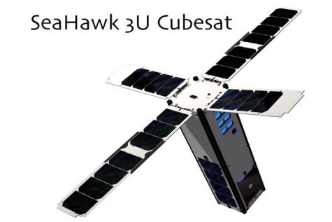
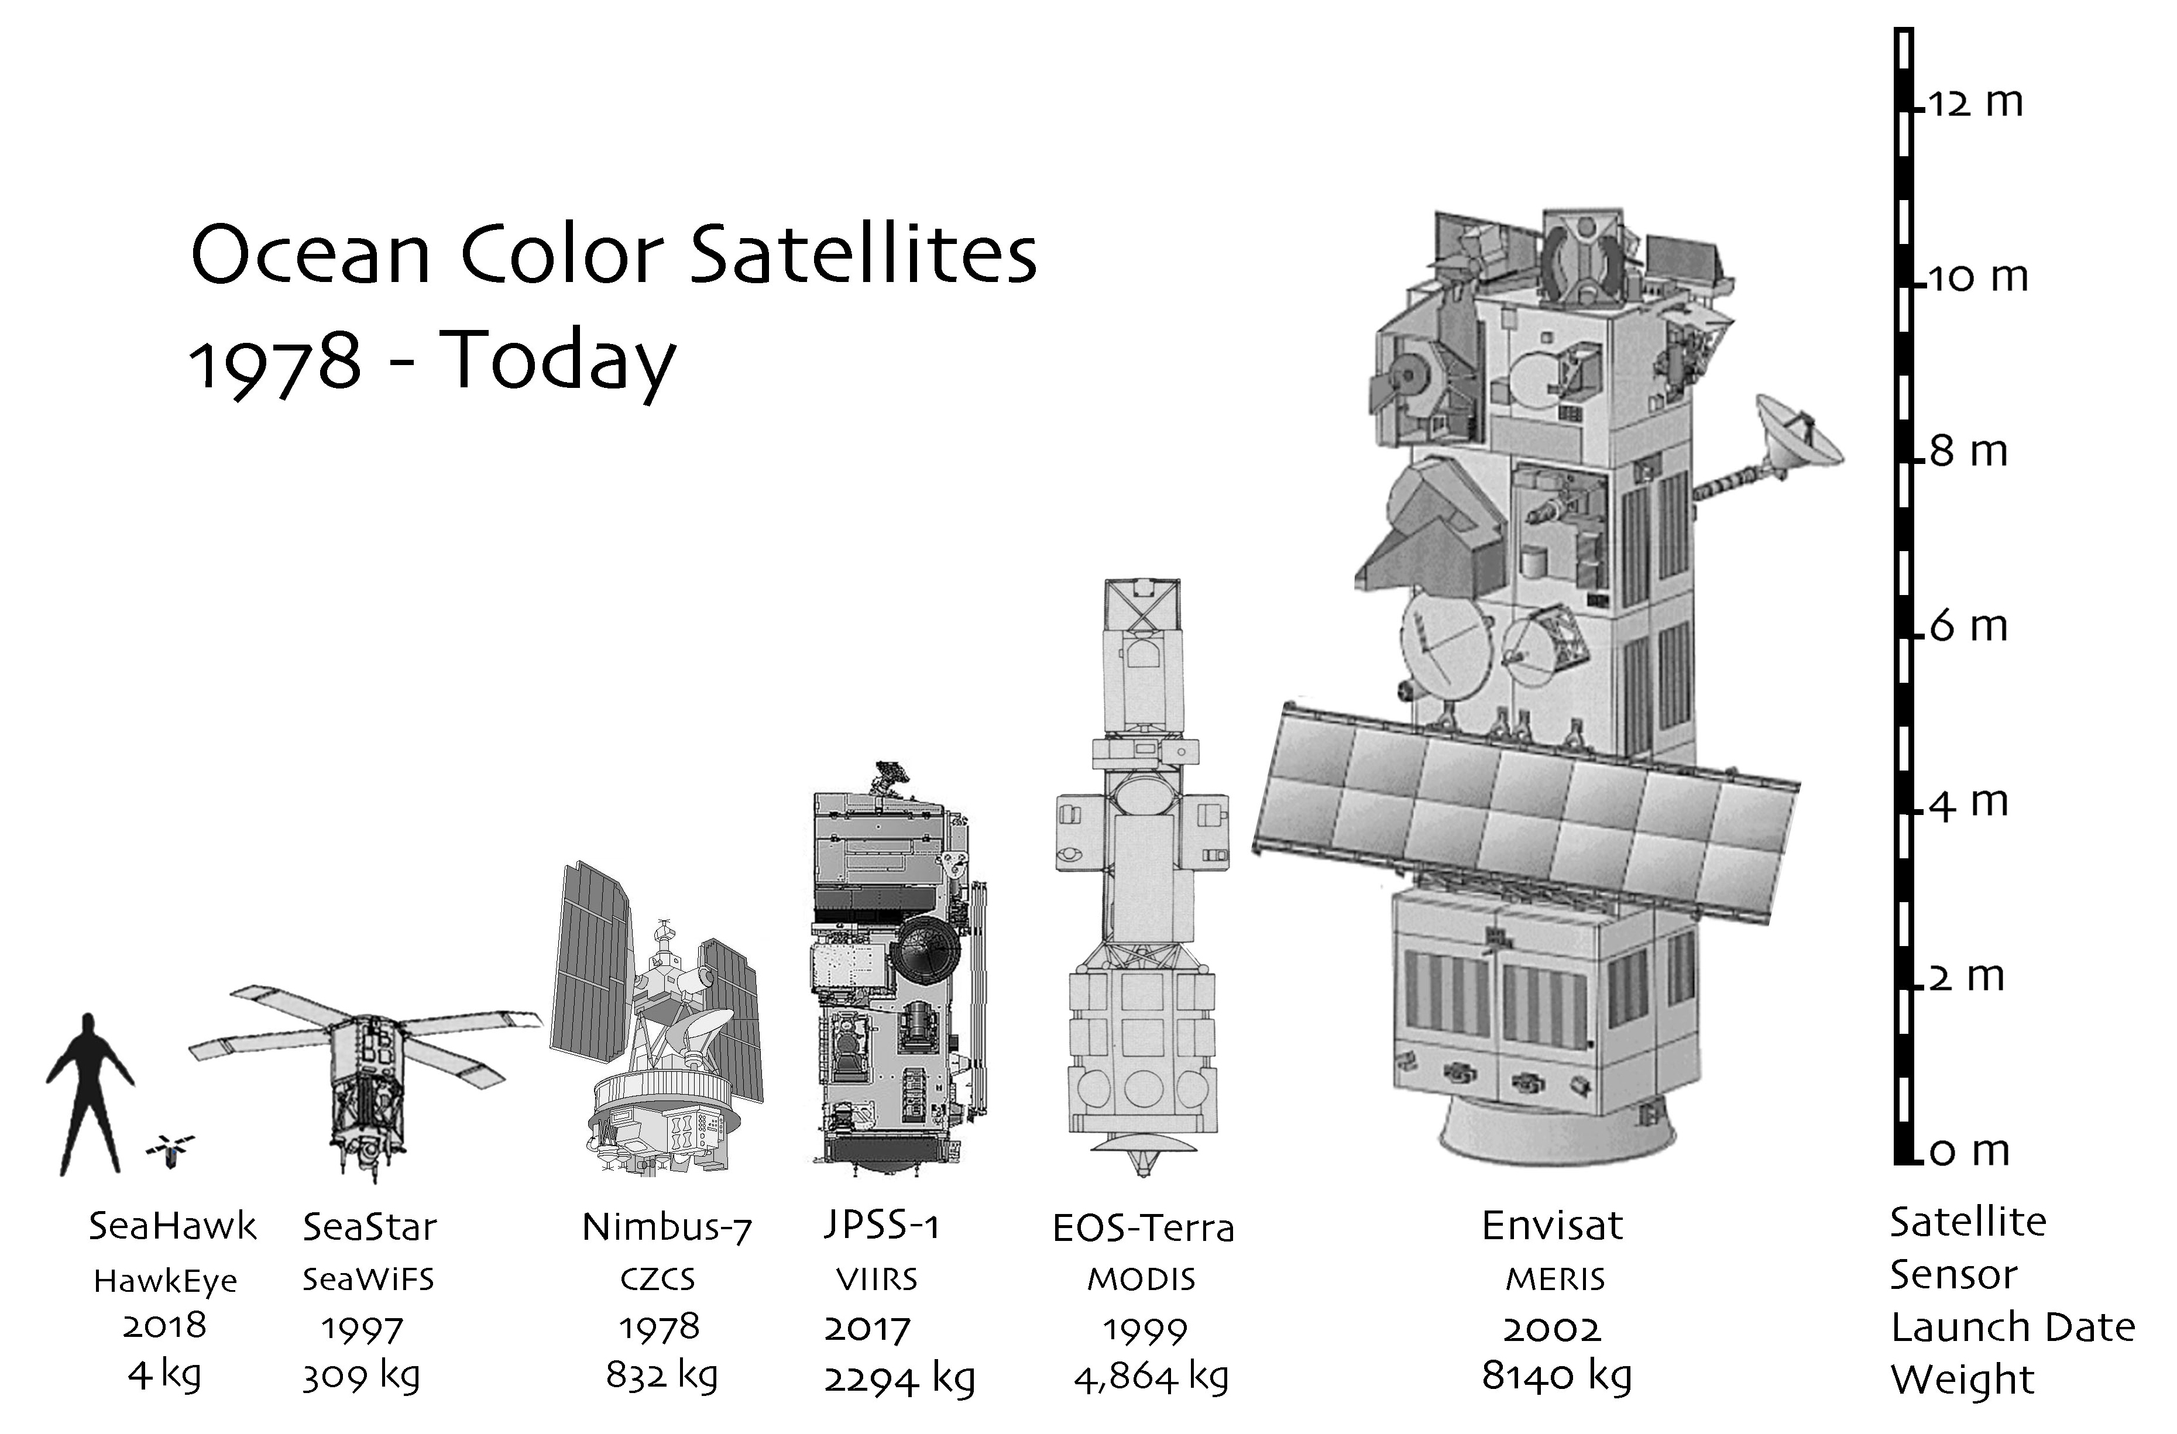
The SeaHawk/HawkEye CubeSat Mission
Launched in 2018, supported by NASA’s Ocean Biology Processing Group.
HawkEye
SeaWiFS
Off the shelf components
2-year development time
$4 million
10 x 10 x 30 cm, 3 kg.
120 m spatial resolution
10-year development time
$100 million
50 x 50 x 200 cm, 309 kg.
1100 m spatial resolution
Potential for a constellation of CubeSats for increased temporal resolution!
Notes:
In 2018, the SeaHawk satellite was launched, marking a shift in the landscape of OCRS through cost-effective Earth observation endeavors. This initiative was supported by NASA’s Ocean Biology Processing Group, demonstrating a commitment to advancing our understanding of coastal ecosystems from space.
The SeaHawk represents a paradigm shift in OCRS due to its efficient design principles. It was developed with off-the-shelf components and completed within a rapid development time of just 2 years at a cost of $4 million. This stands in contrast to the OrbView-1 satellite, which required a decade of development and $100 million in funding. Furthermore, SeaHawk’s compact and lightweight 3U stature, measuring 10 x 10 x 30 cm and weighing 3 kg, is a dramatic departure from the larger 50 x 50 x 200 cm frame and 309 kg weight of OrbView-1.
Despite its efficient design, HawkEye does not compromise performance. It captures its imagery in a spectral distribution akin to SeaWiFS, but with a significant improved spatial resolution of 120 m – an eightfold improvement.
To put this into perspective, 84 HawkEye pixels, each with an area of 120 m2, could fit into a single 1100 m2 pixel of SeaWiFS. This granular level of detail enables HawkEye to bridge the gap between open ocean and coastal RC, enhancing missions like SeaWiFS by providing detailed views of complex marine ecosystems. And with the potential for a constellation of high-resolution marine monitoring CubeSats, we will be able to monitor these regions with unprecedented clarity.

Slide 5
Research Objectives
Field Missions
Collect contemporaneous in-situ and remotely sensed imagery.
Use Acrobat for 3D coverage and handheld spectroradiometer for Rrs.
Imagery Analysis:
Analyze OC imagery from multiple sources including HawkEye, MODIS, etc.
Compare with R/V Cape Fear in-situ data.
Chl Concentrations:
Incorporating in situ and satellite data to investigate spatial variability within the CFRE and Masonboro Inlet.
Matchup Analysis:
Compare satellite and in-situ observations.
Utilize statistical metrics (R2, RMSD, MAPE, etc.) for evaluation.
Research Dissemination:
Publish in a reputable scientific journal.
Share methodologies and datasets with the scientific community.
Notes:
Given the improvements offered by the HawkEye imagery, combined with the necessity for in-situ validation in ocean color remote sensing, especially in coastal ecosystems, my research objectives involves:
The collection of contemporaneous in-situ and RS imagery to obtain a comprehensive view of the marine landscape. We employ tools like the Acrobat for 3-ddimensional coverage and handheld spectroradiometer for retrieving Rrs data.
Our imagery analysis then takes center stage. By analyzing OC imagery from multiple sources, including the innovative HawkEye sensor and established instruments like MODIS, we can draw comparative qualitative insights. The R/V Cape Fear’s in-situ data serves as a benchmark for validating and understanding the spaceborne observations.
Next, we will delve into chlorophyll concentrations, incorporating in-situ and satellite data to unravel the spatial variability within the Cape Fear River Estuary (CFRE) and Masonboro Inlet. This comprehensive approach allows us to paint a detailed picture of the nutrient and biomass distribution in these dynamic marine environments.
Matchup analysis is also a key component of our methods. By comparing satellite and in-situ observations, we can refine our understanding of ocean color data. The use of statistical metrics, such as the coefficient of determination (R2), Root Mean Square Deviation (RMSD), and Mean Absolute Percentage Error (MAPE), among others, provides us with a quantitative assessment of our data’s accuracy and reliability.
Finally, the dissemination of our research is as important as the research itself. Publishing out findings in a reputable scientific journal ensures that our work contributes to the collective knowledge of the scientific community. Furthermore, by sharing our methods and datasets, we encourage collaboration, stimulate further research, and contribute to the ever-growing body of oceanographic knowledge, ensuring that the exciting capabilities of the HawkEye sensor are leveraged to their fullest potential.

Slide 6
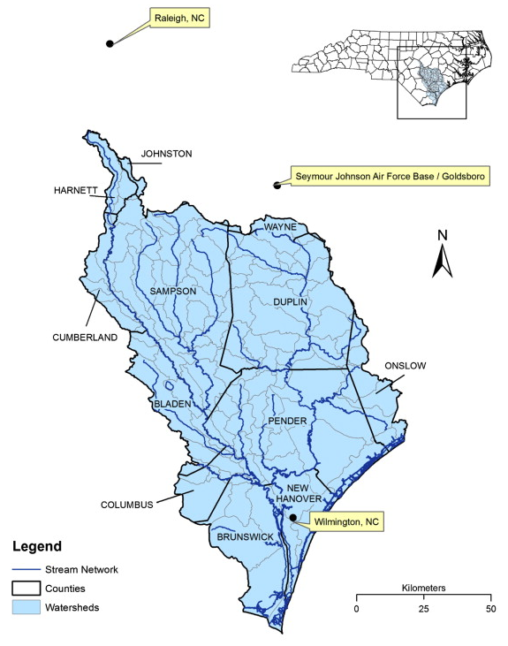
Study region
Cape Fear River Basin (CFRB):
High CAFO Density
Livestock counts: 10 million hogs, 16 million turkeys, 300 million chickens.
Urbanization and Industrialization
One-fifth of NC’s population resides near the CFRB.
Nutrient load impact into downstream flow.
Griffin et al., 2013
Notes:
The Cape Fear River Basin (CFRB) serves as an environmental nexus at the confluence of intensive agriculture operations, rapid urbanization, and industrial activity. This region is notable for having the highest density of Concentrated Animal Feeding Operations (CAFOs) in the world. With staggering livestock counts that include 10 million hogs, 16 million turkeys, and 300 million chickens, the scale of animal agriculture is immense.
This stands against the backdrop of North Carolina’s urban sprawl, with approximately one-fifth of the state’s population residing in cities near the river, such as Durham, Chapel-Hill, Fayetteville, and Wilmington. These urban centers, along with the expansive CAFOs, are significant contributors to the nutrient loads entering the river system. These nutrients, primarily from animal waste and urban runoff, are carried downstream through the heart of Wilmington and eventually discharged in the Atlantic Ocean.

Slide 7
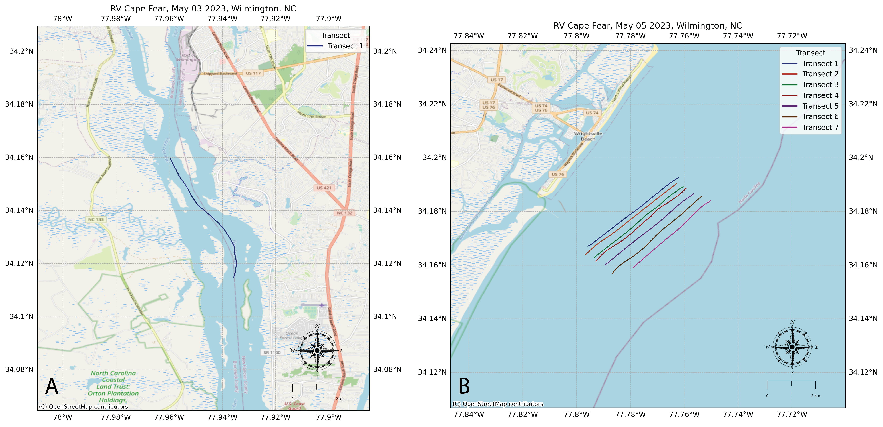
May 3, 10 am – 1 pm: Cape Fear River
Focus: Technical evaluation of the Acrobat instrument.
Result: Valuable data obtained, though limited in quantity.
Ecology:
Significant discharge
Nutrient rich groundwater from upstream CAFOs
May 5 , 10 am – 2 pm: Masonboro Inlet
Focus: Data collection at the mouth.
Ecology:
Masonboro Inlet connects shoreface zone with continental shelf and subaerial coastal plain.
Wrightsville Beach: A high-energy, wave-dominated, microtidal barrier island.
Notable Development: Beach undergoes frequent major replenishments due to its built-up nature.
Notes:
Our study aims to capture detailed snapshots of nutrient discharge along the Cape Fear River Estuary (CFRE), and for this purpose, we have strategically positioned our study sites along the downstream flow. We collected our dataset during two field excursions on the R/V Cape Fear on May 3 and 5, 2023.
On May 3rd we sampled in the CFR near downtown Wilmington. Although the primary focus for this date was the technical evaluation of the Acrobat instrument, we were able to gather some valuable data. Even though the data collected on this data was limited in quantity, it provided us with initial insights into the nutrient concentrations in this area of the river.
Building on the preliminary data, on May 5^{th,} we sampled at the mouth of the Masonboro Inlet, adjacent to the shoreface zone of Wrightsville Beach. Characterized as a high-energy, wave-dominated, microtidal barrier island, this location offered crucial vantage point. The transects we conducted were planned to monitor the point of discharge form the CFRE, thereby enabling us to assess the nutrient loads was they transition from estuary to the ocean.

Slide 8
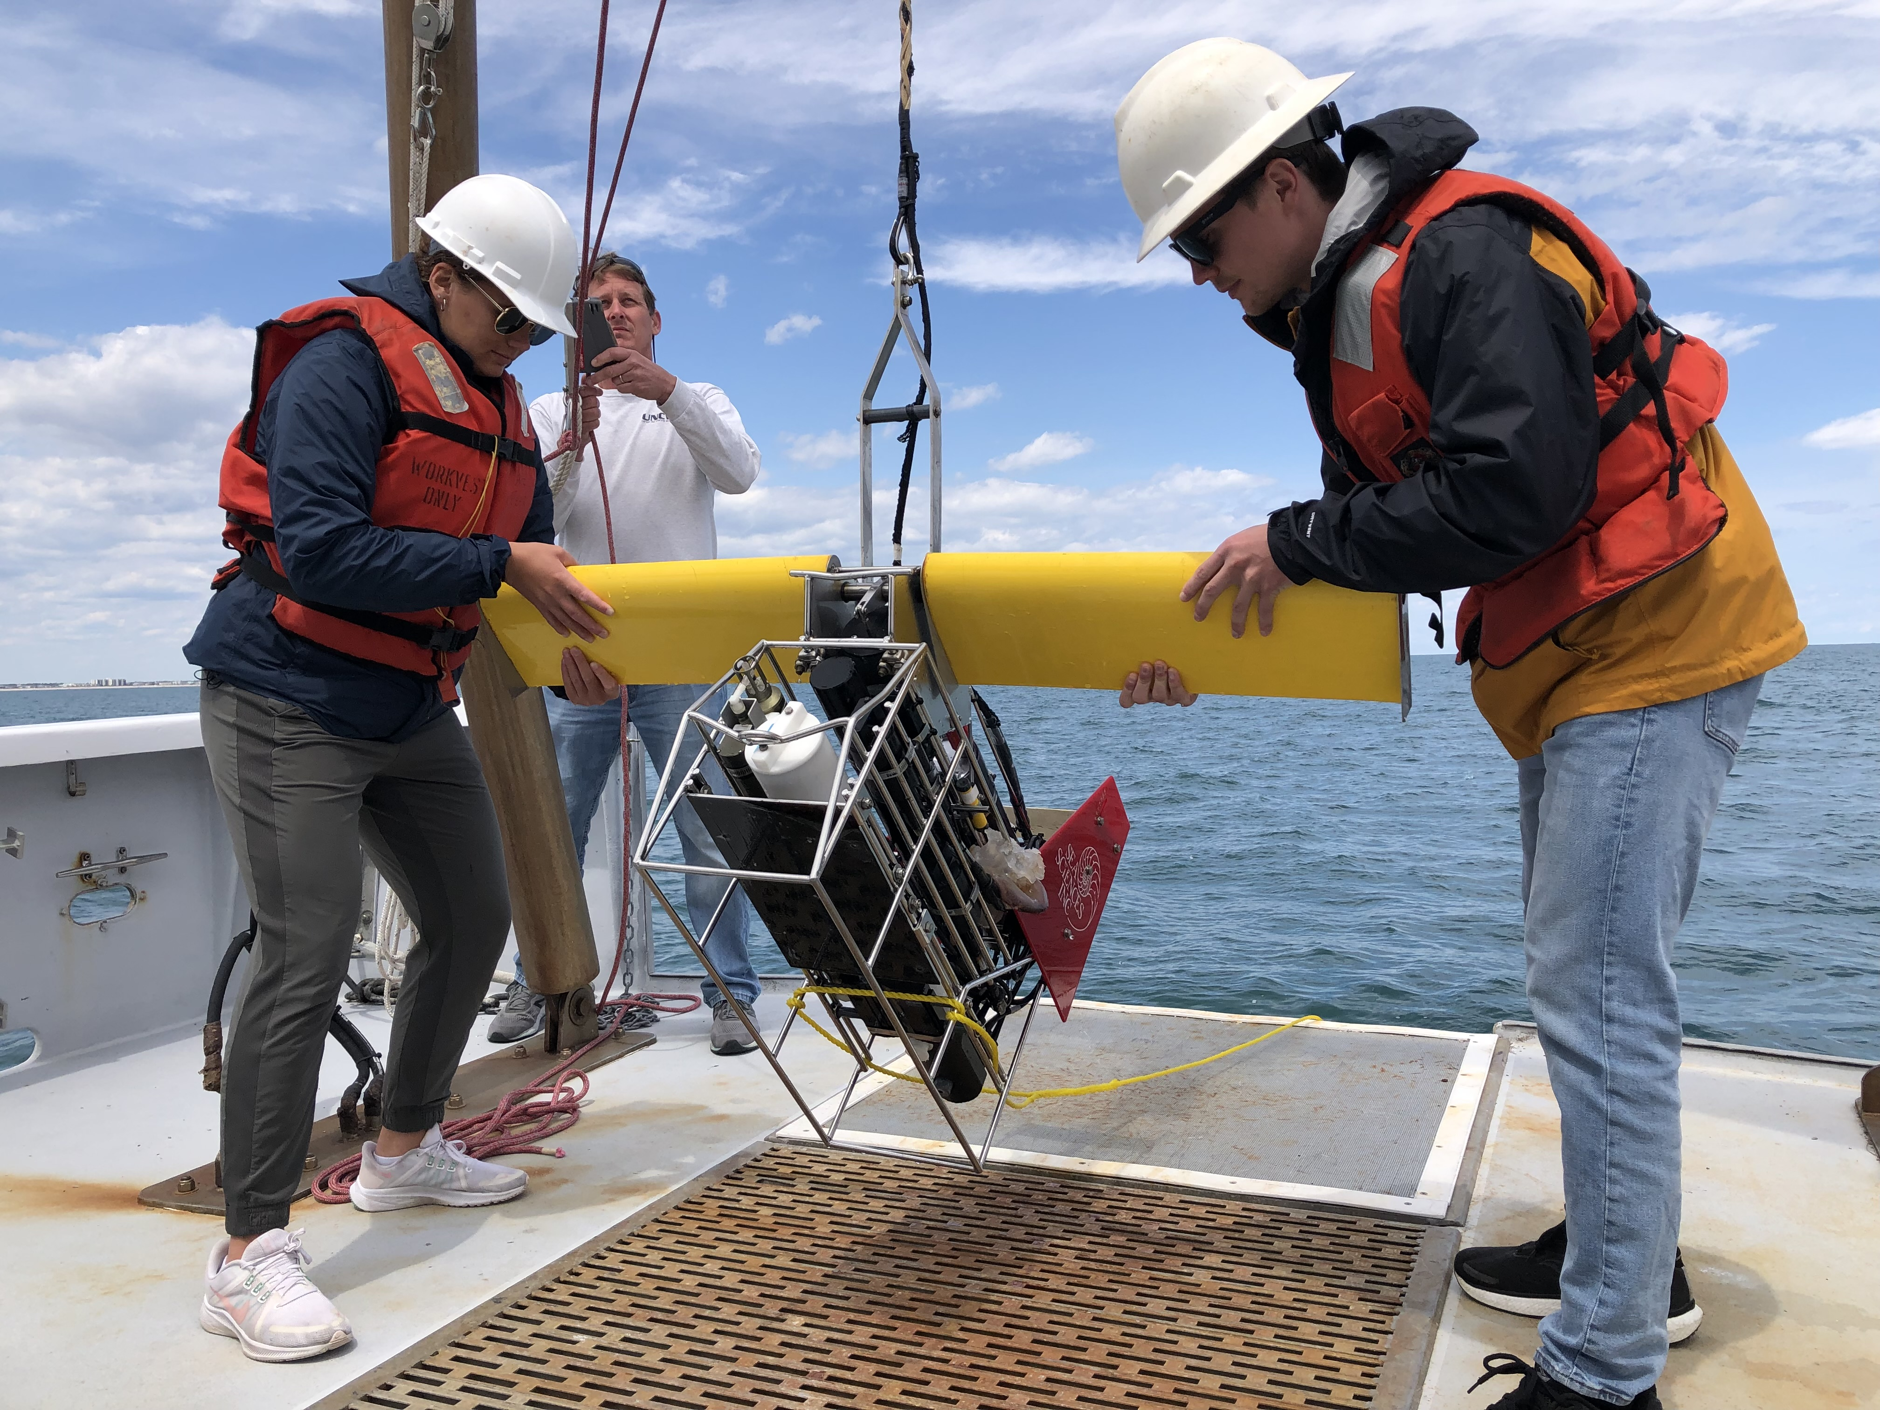
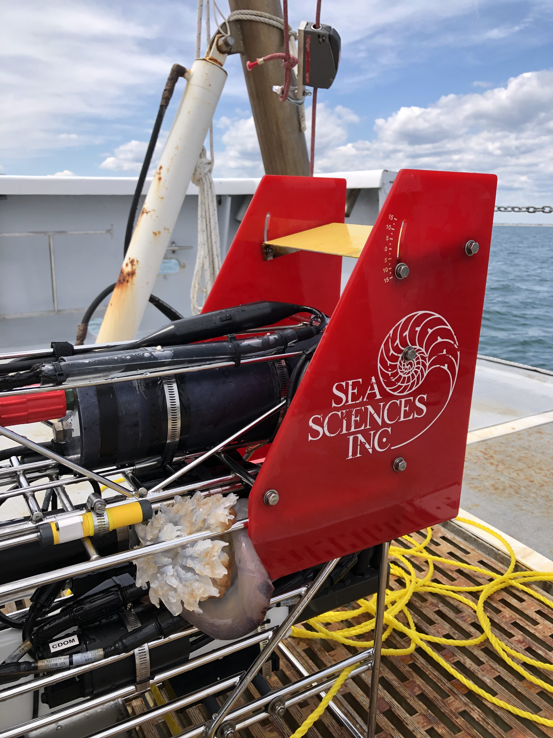
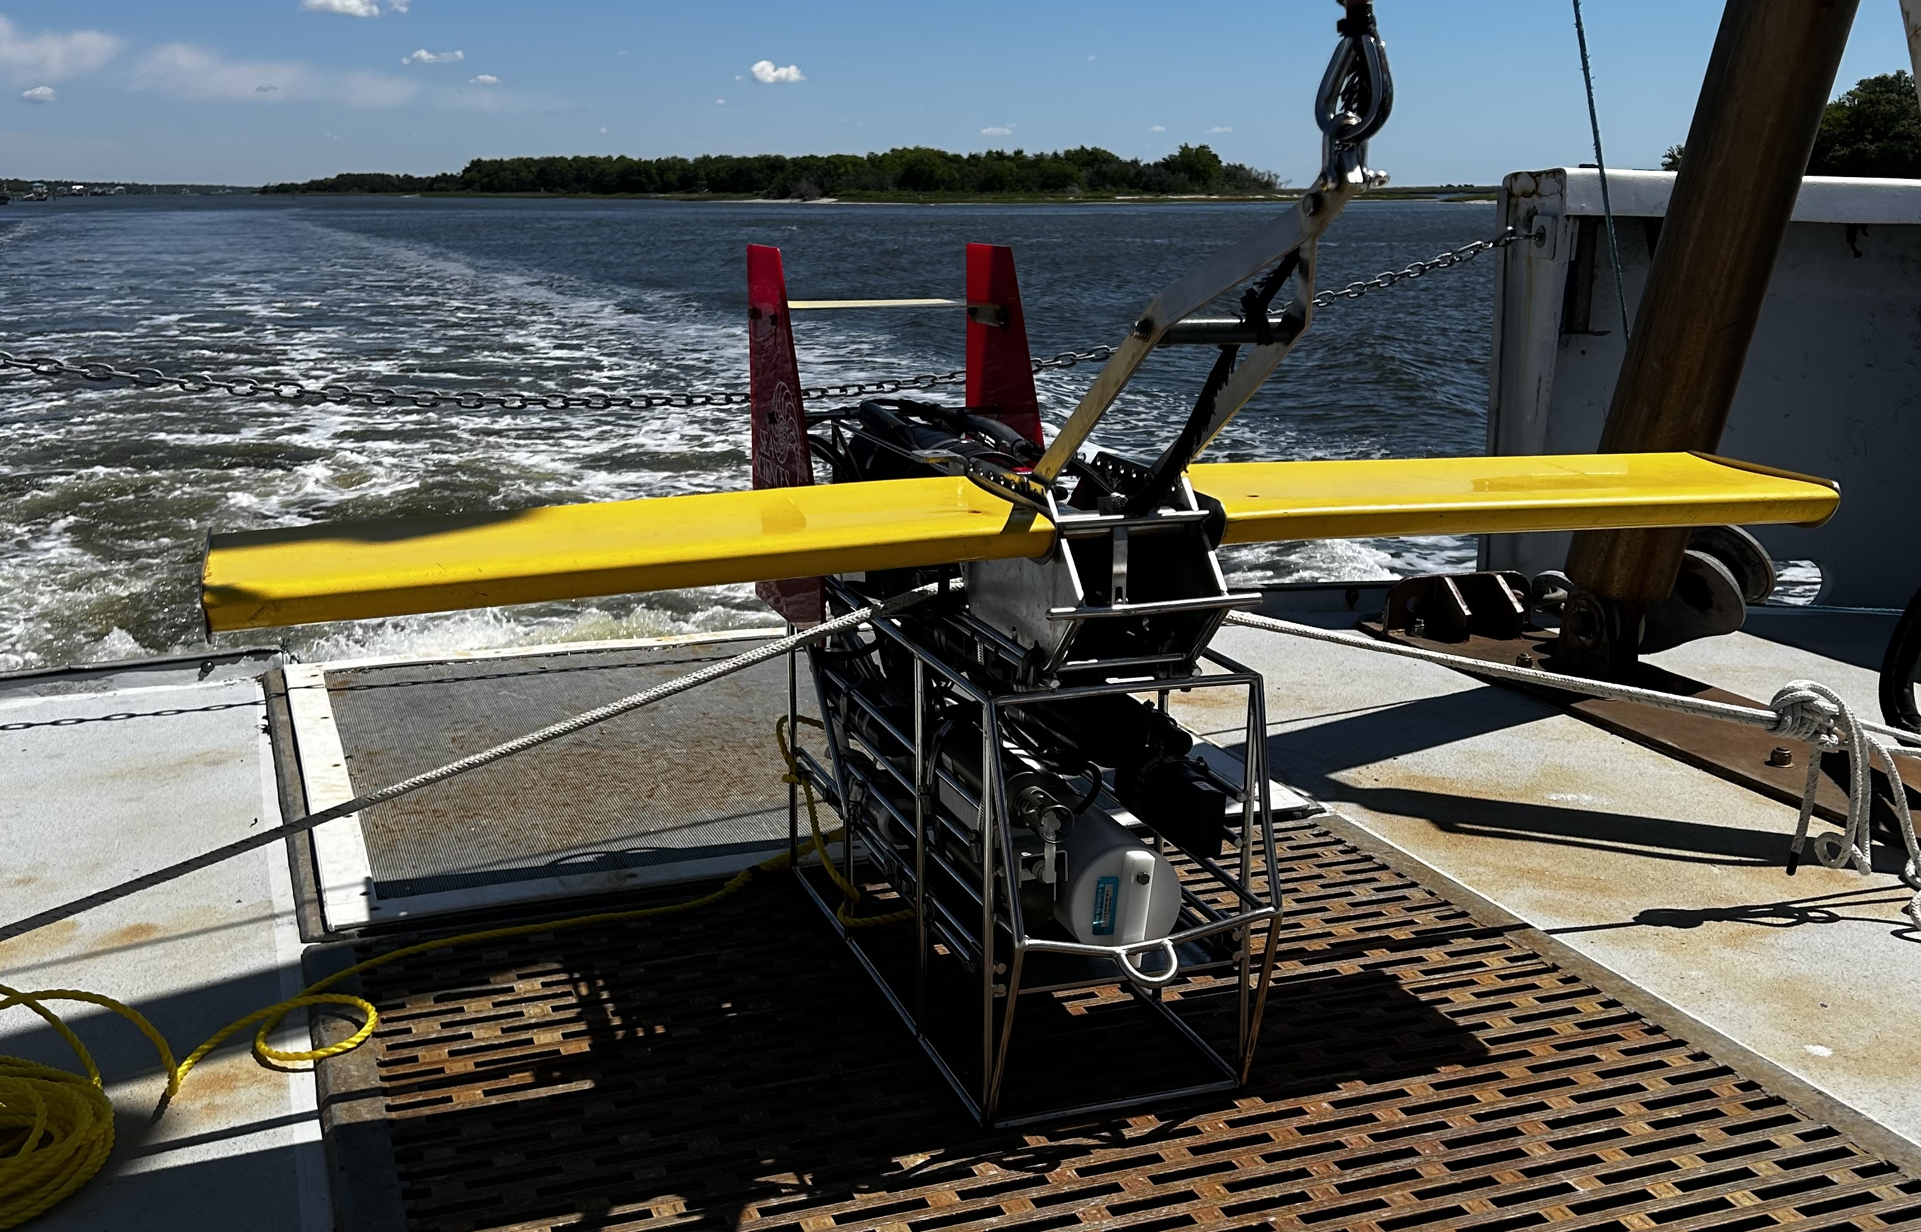
In Situ Instrumentation
The Acrobat, a towed research platform by Sea Sciences Inc.
Auxiliary Instruments:
Seabird SBE 25 plus Sealogger CTD
Seabird SBE 4 Conductivity
Seabird 43 Oxygen sensor
Seapoint Chlorophyll Fluorometer
Seapoint Ultraviolet Fluorometer
Seapoint Turbidity Meter
Benefits:
Real-time data acquisition
Instantaneous evaluation of water column properties via onboard computer monitors
Notes:
We obtained our in-situ data using the Acrobat, a versatile towed vehicle designed for marine research applications by Sea Sciences Inc. We added the following instruments to Acrobat’s frame to facilitate sampling: Seabird SBE 25 plus Sealogger CTD, Seabird SBE 4 Conductivity, Seabird 43 Oxygen sensor, Seapoint Chlorophyll Fluorometer, Seapoint Ultraviolet Fluorometer, and Seapoint Turbidity Meter.
These instruments allowed for real-time data acquisition and the instantaneous evaluation of water column properties via the onboard computer monitors.

Slide 9
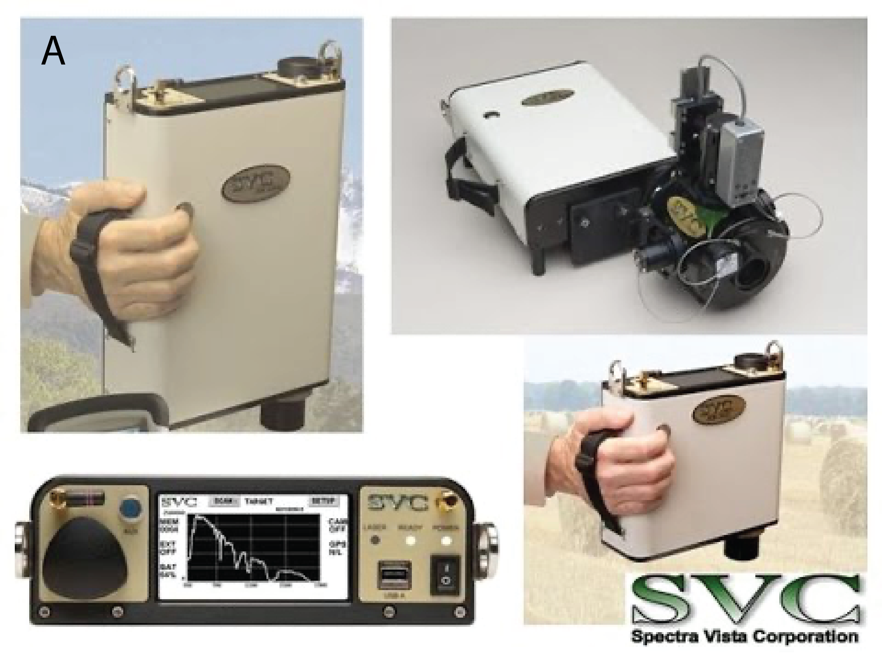
In-situ Remote Sensing Reflectance Measurement
HR-512i handheld spectroradiometer by Spectra Vista Corporation.
Spectral channels: 512, spanning 350 nm – 1050 nm.
Measurements: downwelling irradiance and upwelling radiance (Lu).
Purpose: juxtapose in situ Rrs readings against Rrs for satellites to add another layer of remotely sensed oceanic parameter evaluation.
Notes:
To enhance our evaluation, we incorporated the HR-512i handheld spectroradiometer, engineered by Spectra Vista Corporation, into our suite of in situ instruments. This spectroradiometer covers 512 spectral channels that cover a broad wavelength range from 350. nm to 1050 nm. It’s designed to measure both downwelling irradiance and upwelling radiance, which can be processed into Remote Sensing Reflectance (Rrs), which can be directly compared to satellite retrievals.

Slide 10
Satellite Data Acquisition
May 3rd Expedition - 2 Images
May 5th Expedition - 6 Images
In-situ measurements at Cape Fear River: 10 am – 1 pm EST.
x1 - Sentinel-3B OLCI, May 3, 14:48:56
x1 - Landsat-8 OLI, May 3, 15:46:39.
In-situ measurements at Masonboro Inlet: 10 am - 2 pm EST.
x2 - HawkEye, May 6, 15:08:41, and May 7, 15:09:55.
x1 - Sentinel-3A OLCI, May 7, 15:34:21.
x2 - Sentinel-3B OLCI, May 6, 15:21:10, and May 7, 14:54:59.
x1 - MODIS-Aqua:, May 7, 18:45:01.
Challenges: Other satellite platforms on this dates were affected by dense cloud coverage or lacked coverage.
Notes:
Study utilizes satellite data from multiple platforms, including MODIS-Aqua, Sentinel 3A/3B, Landsat 8 OLI, and SeaHawk HawkEye.
Targeted regions: Lower CFRE and Masonboro Inlet
Acquired via Ocean Color Web
Emphasis on imagery from in situ water sampling dates (May 3 & 5)
Initial data: Level-1A TOA sensor readings
Processed into: Remote sensing reflectance and related level-3 products (chla, kd_490, etc.) via SeaDAS v8.10.
Quality control flags: ATMFAIL, LAND, HILT, HISATZEN, STRAYLIGHT, CLDICE, COCCOLITH, LOWLW, CHLFAIL, NAVWARN.
Importance of Temporal Stability: while its ideal for in situ measurements and satellite overpasses to line up temporally, given the lack of extreme weather events suggest water quality metrics stability. Therefore, images collected within 24-48 hours post in-situ sampling will meet the needs of this study. Previous studies found satisfactory results despite temporal gaps. However, recognizing the inherent variability of inlets in both space and time, this assumption will be rigorously tested in the subsequent analysis.

Slide 11
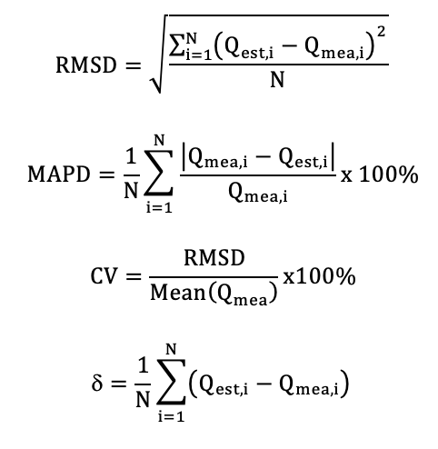
Match-Up Analysis and Accuracy Evaluation
Match-Up Methodology:
In situ measurements paired with satellite observations.
Proximity-based latitude and longitude identification.
Analysis of 3 x 3 pixel matrix centered on in situ point.
Deriving key statistics: mean, median, and coefficient of variation.
Accuracy Evaluation for Rrs and Chl Concentrations:
Coefficient of determination (R2)
Root Mean Square Difference (RMSD)
Mean Absolute Percentage Error (MAPE)
Bias.
Metric Calculation:
Formulated using differences between estimated (Qest,i) and measured values (Qmea,i), that are commonly used in satellite data evaluation studies.
E
Notes:
Ensuring accurate data alignment between in situ and satellite observations is crucial for effective remote sensing evaluation. Comprehensive statistical analysis allows for rigorous data verification and accuracy assessment.
RMSD: quantitative measure of the similarity between observed and estimated values on superimposed coordinates
MAPE: the average percent difference between predictions and the actual values
CV: shows and measures the variability in data sets. It’s the ratio of the standard deviation to the mean. The higher the CV, the greater level of dispersion around the mean.
Bias of an estimator (or bias function): the difference between this estimator’s expected value and the true value of the parameter being measured. A value of 0 is called unbiased.

Slide 12
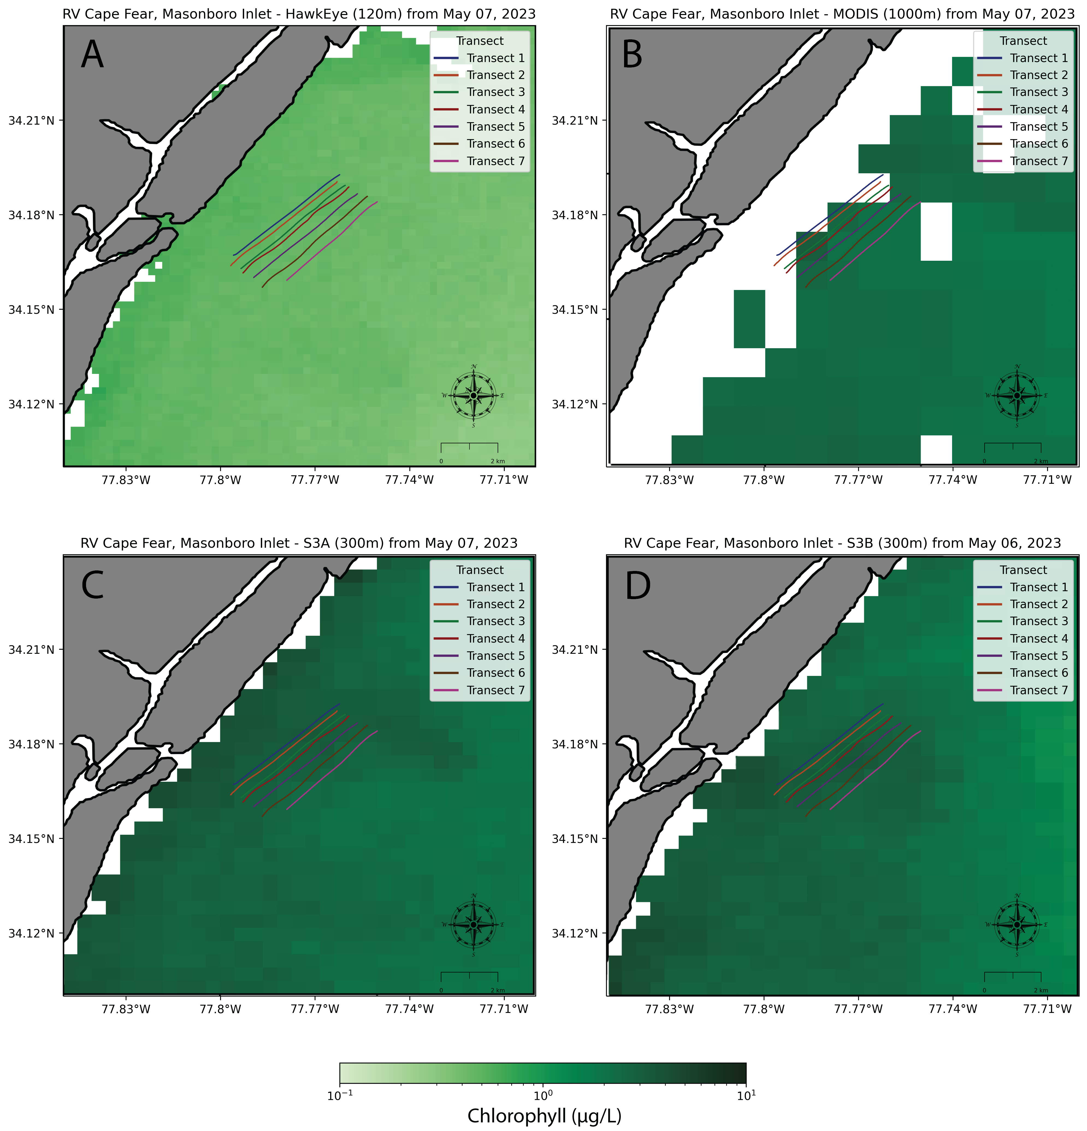
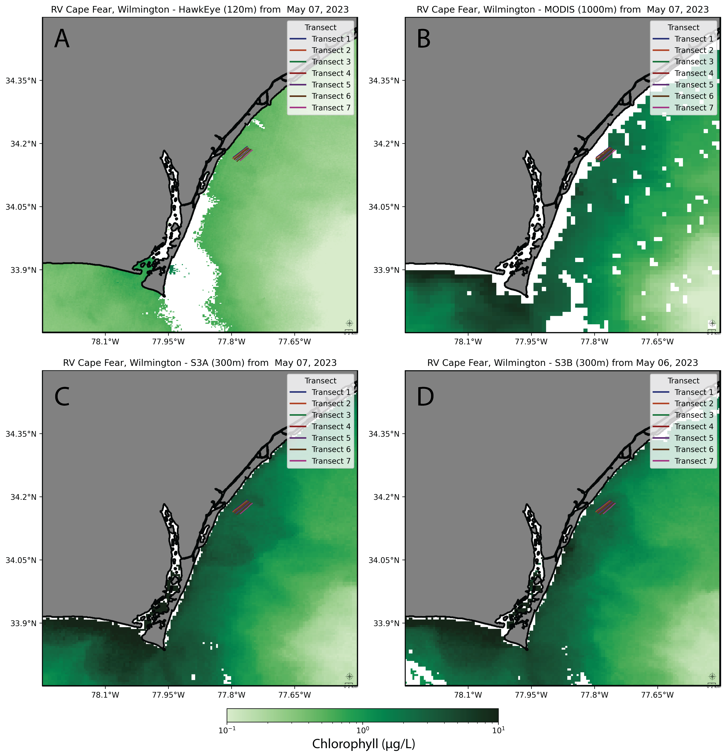
Preliminary results

Slide 13
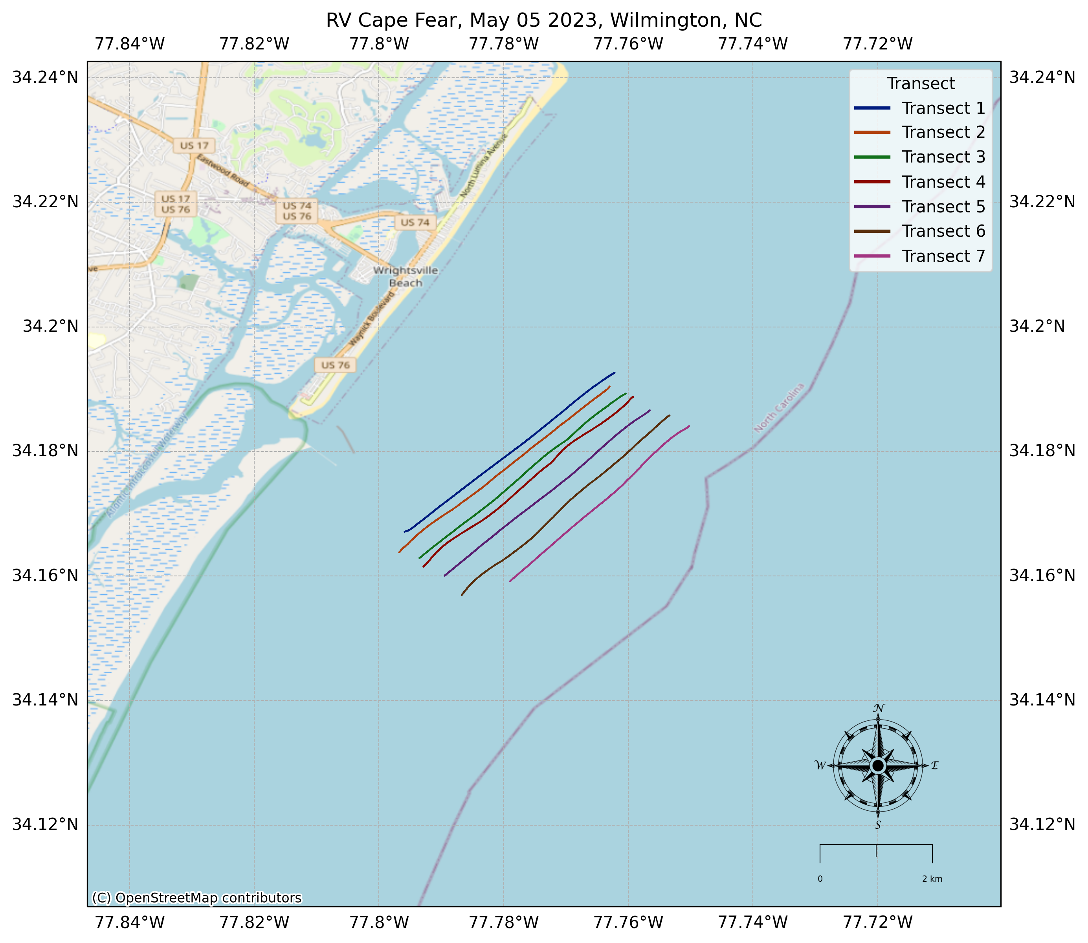
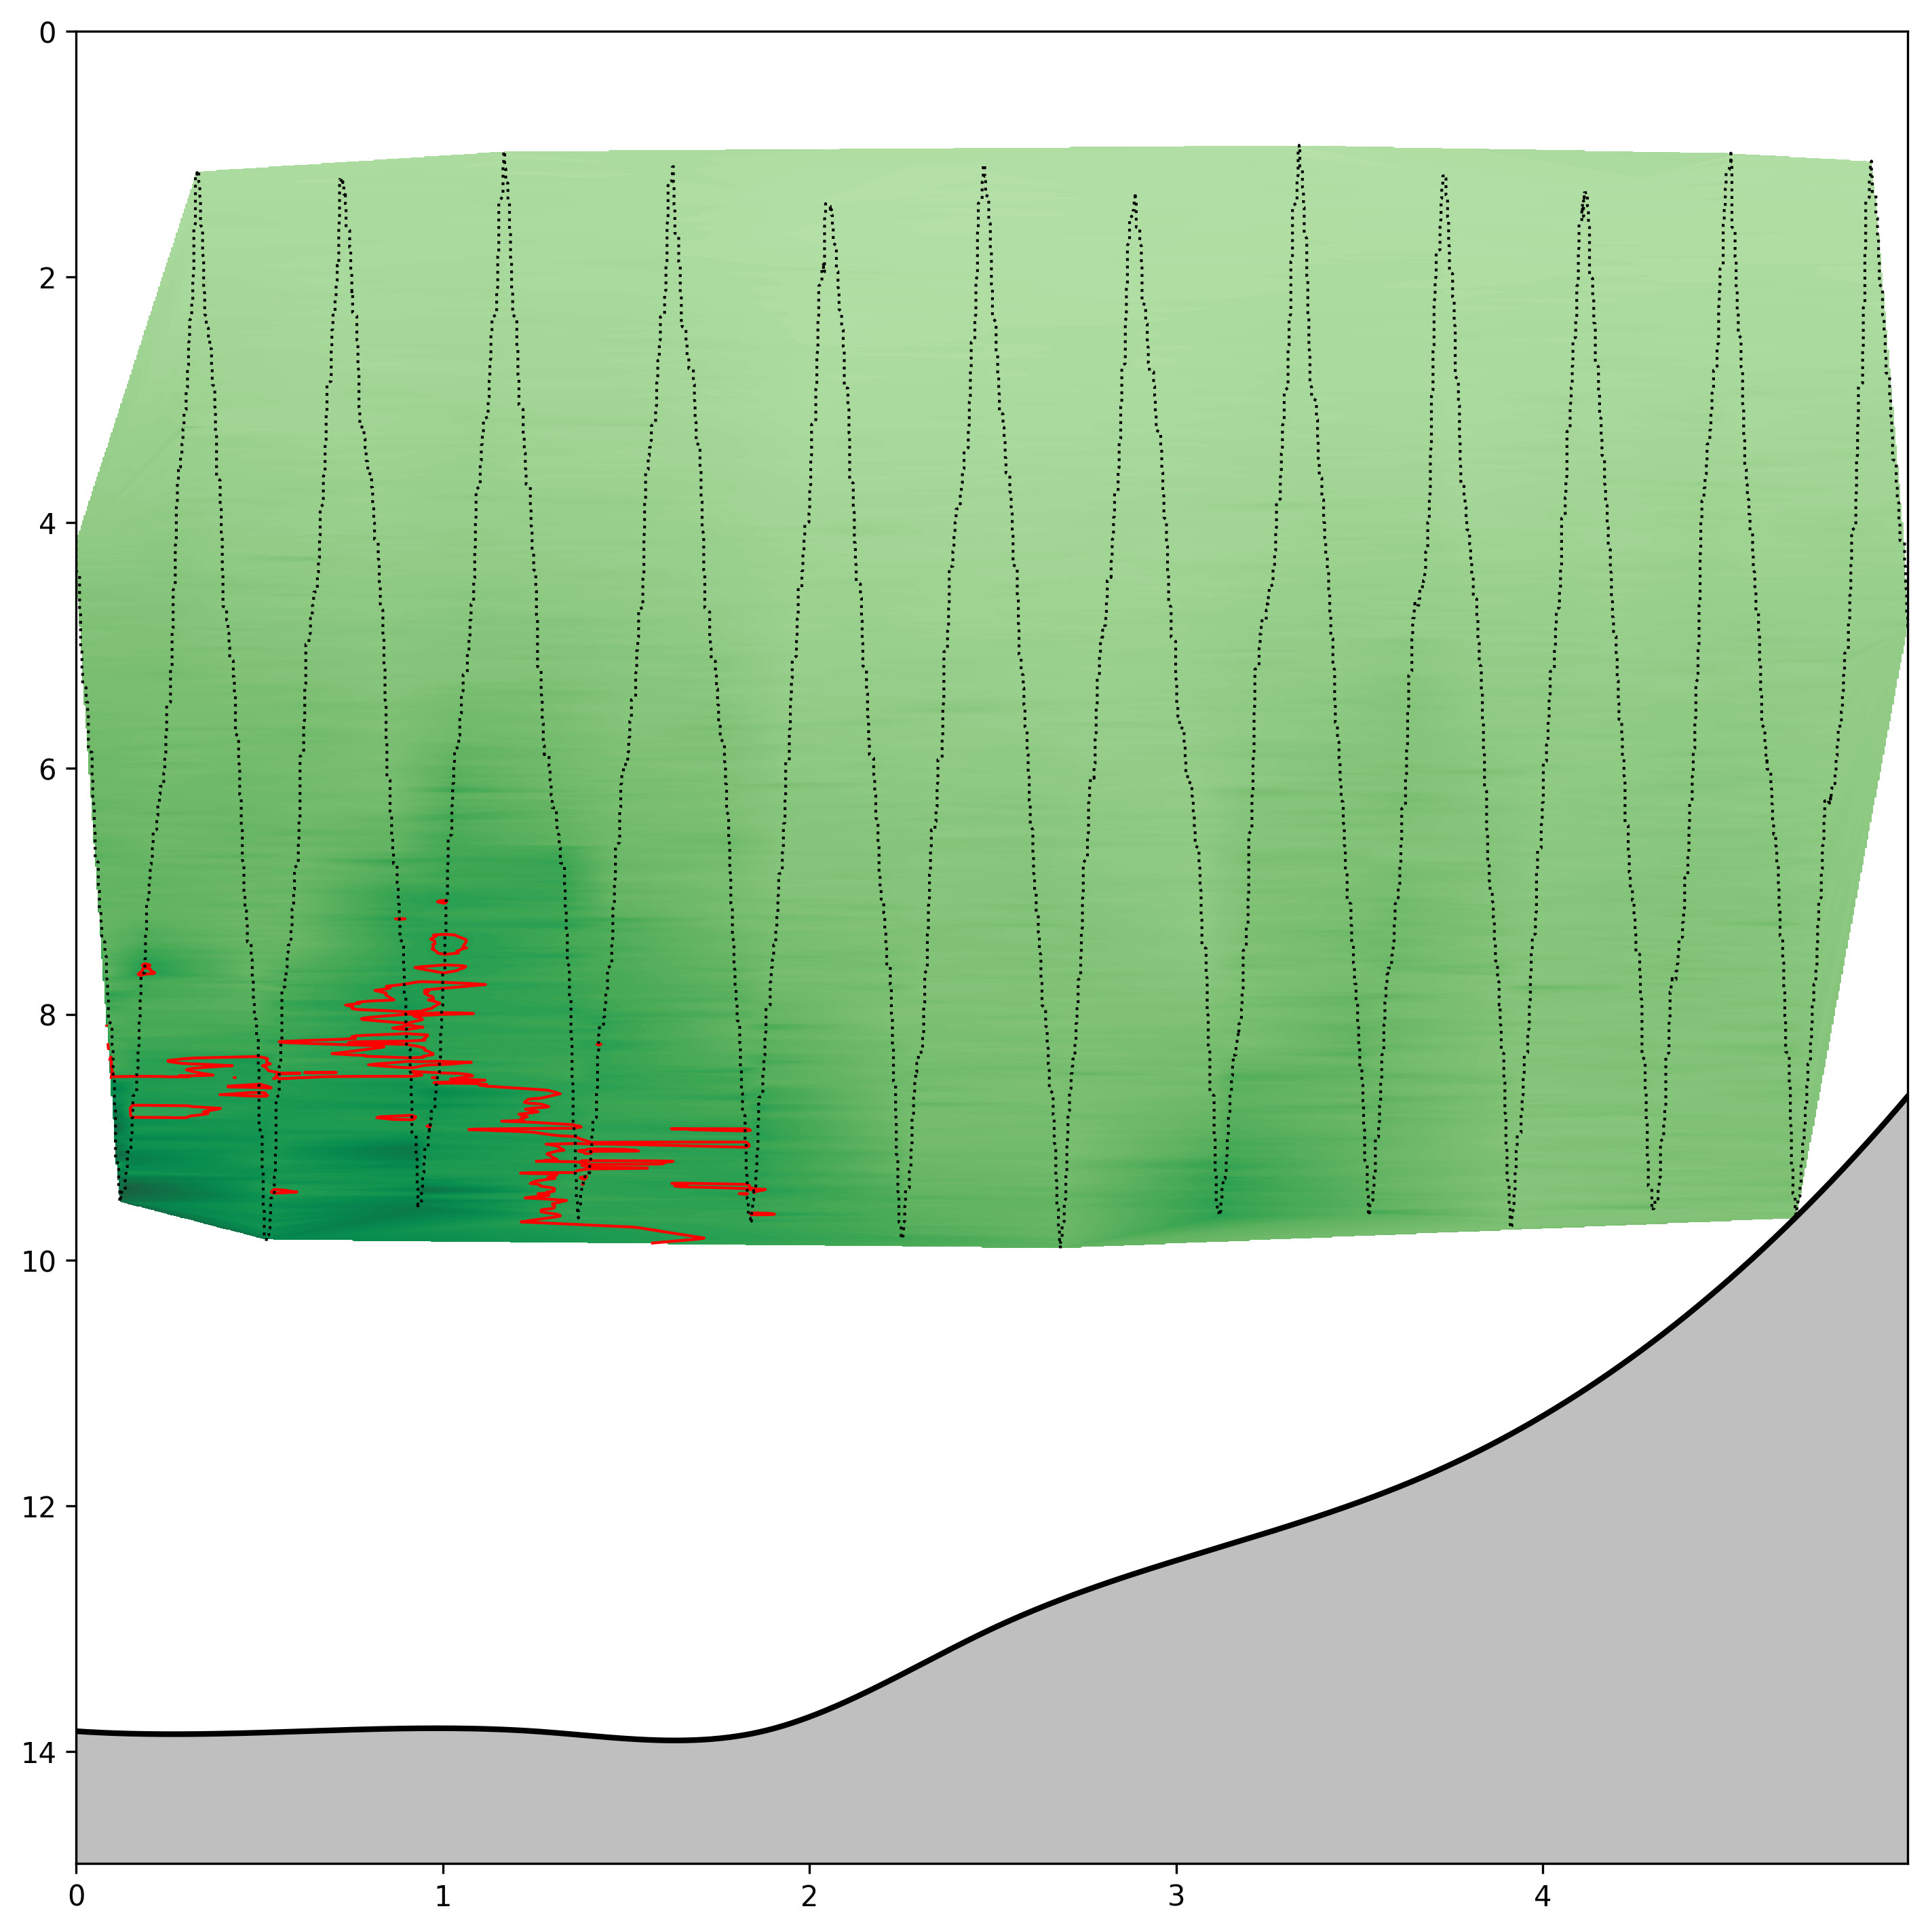
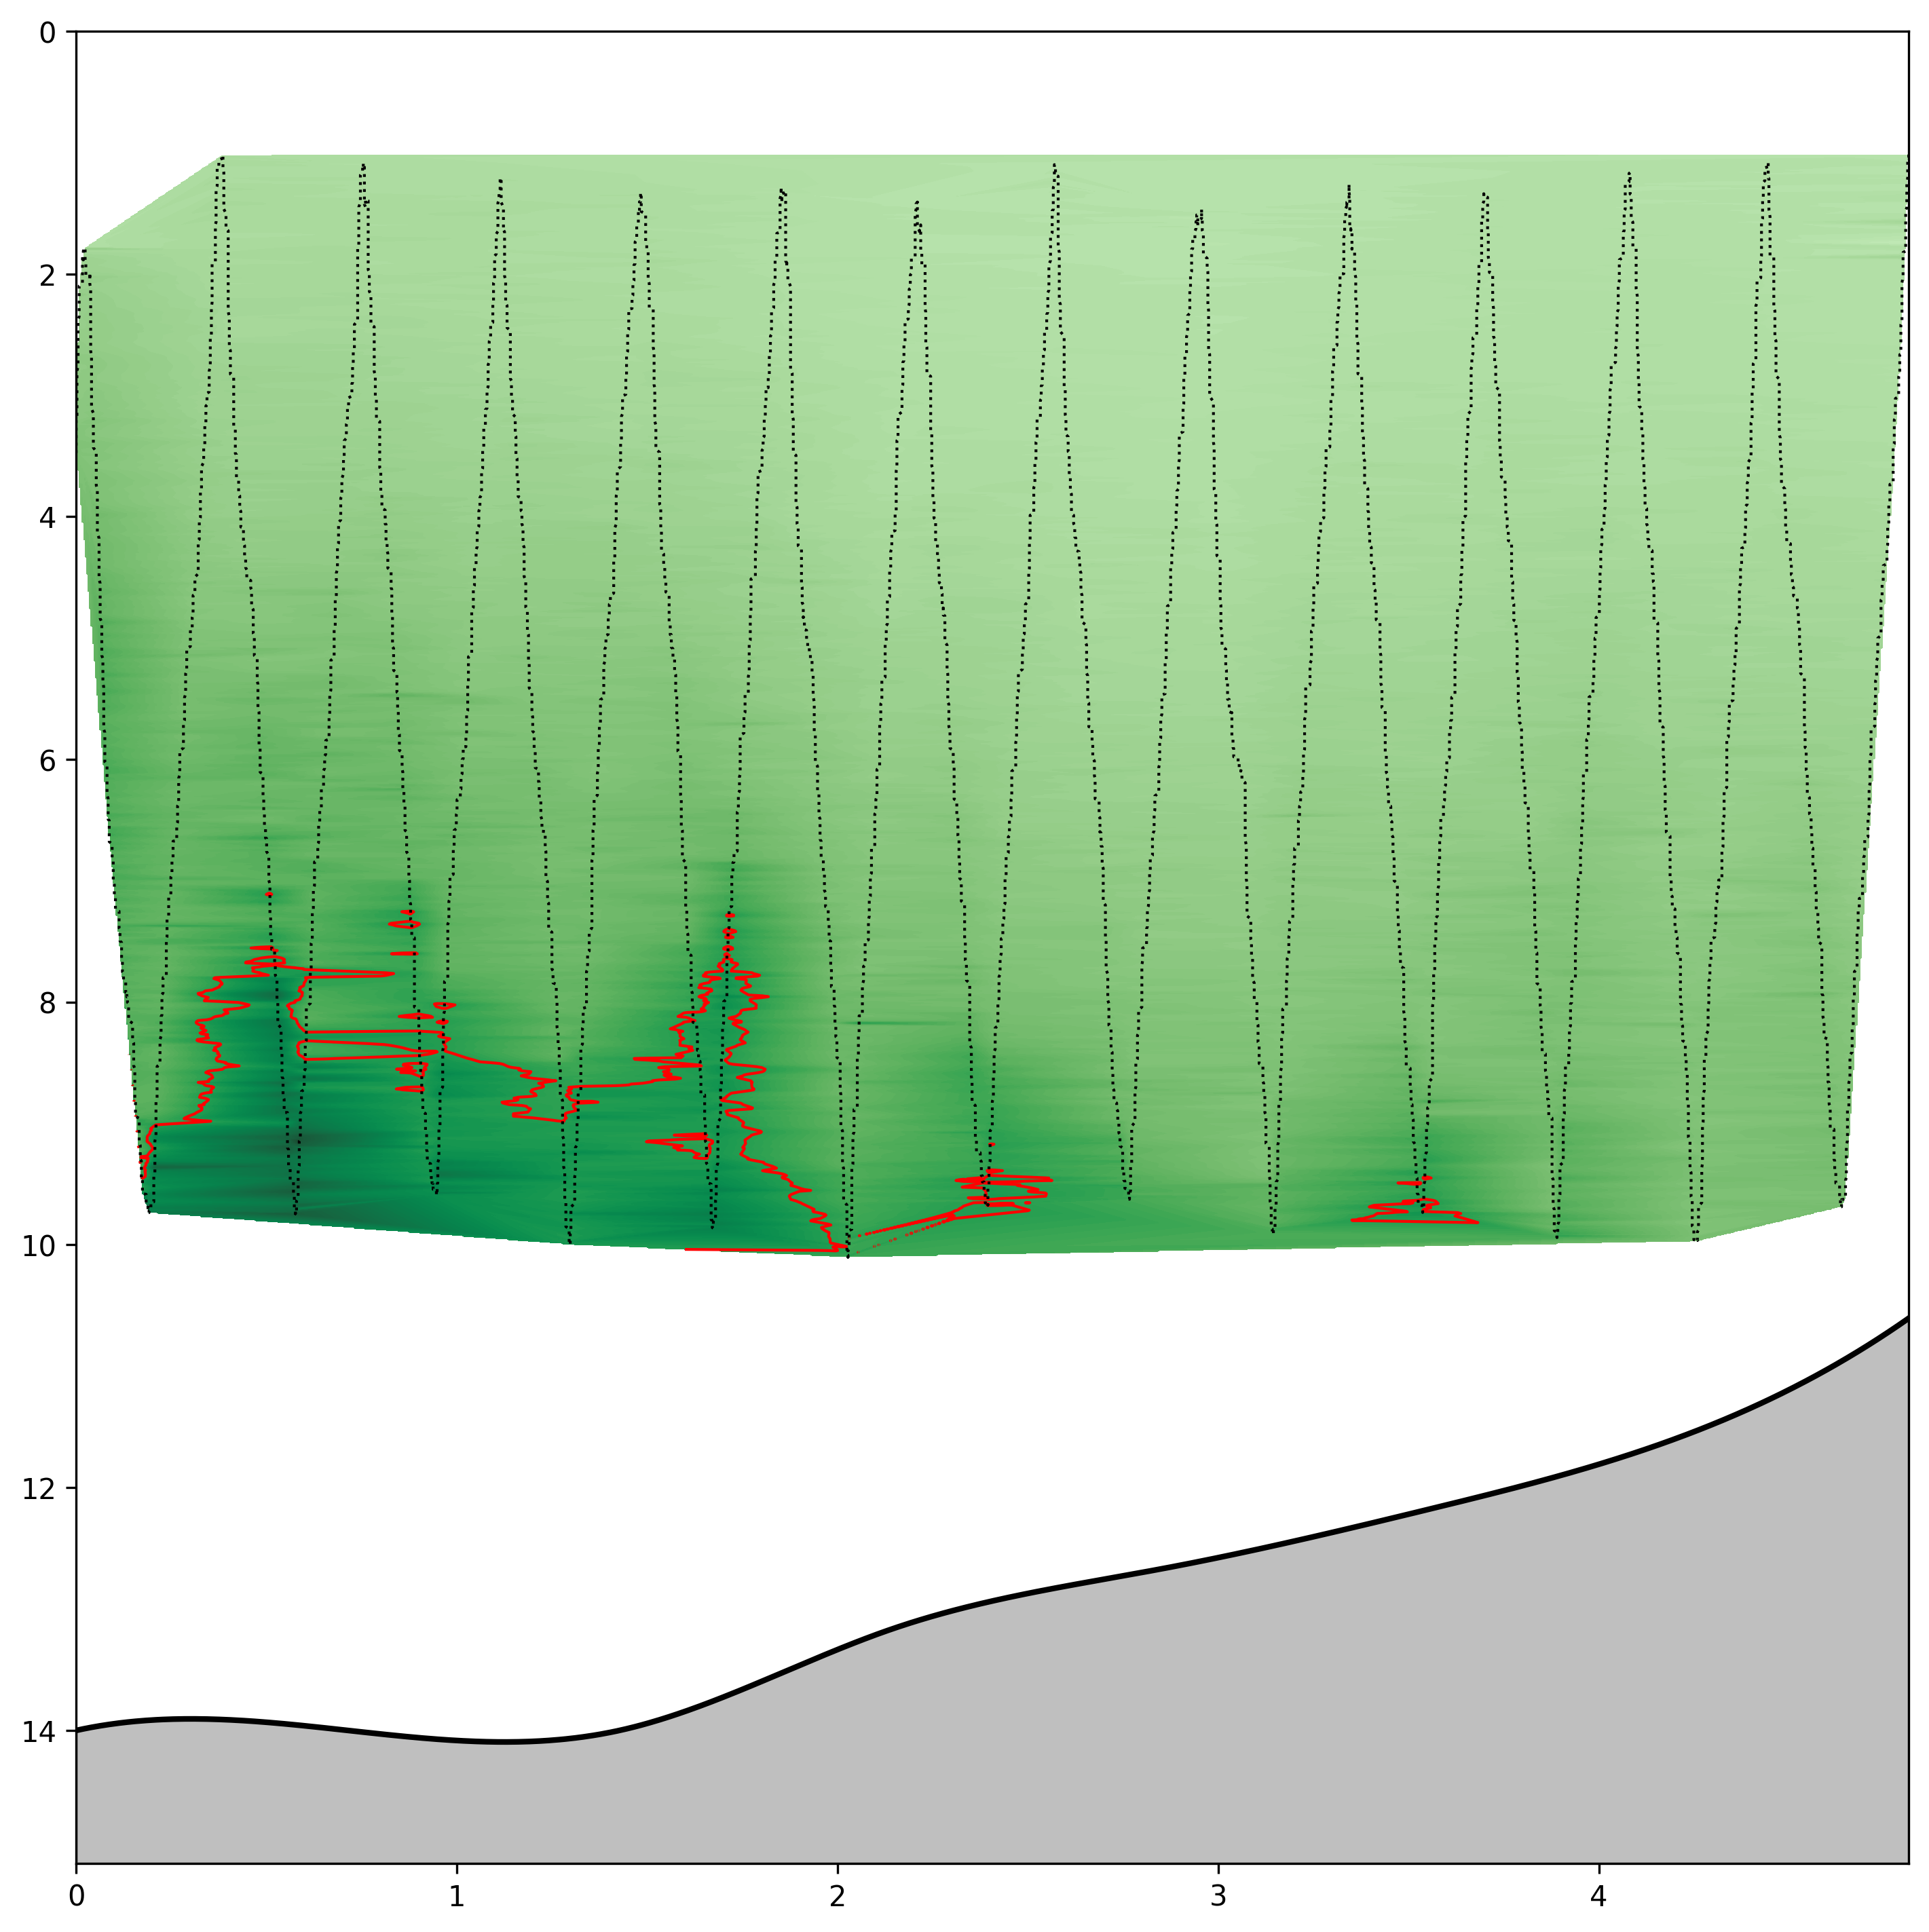
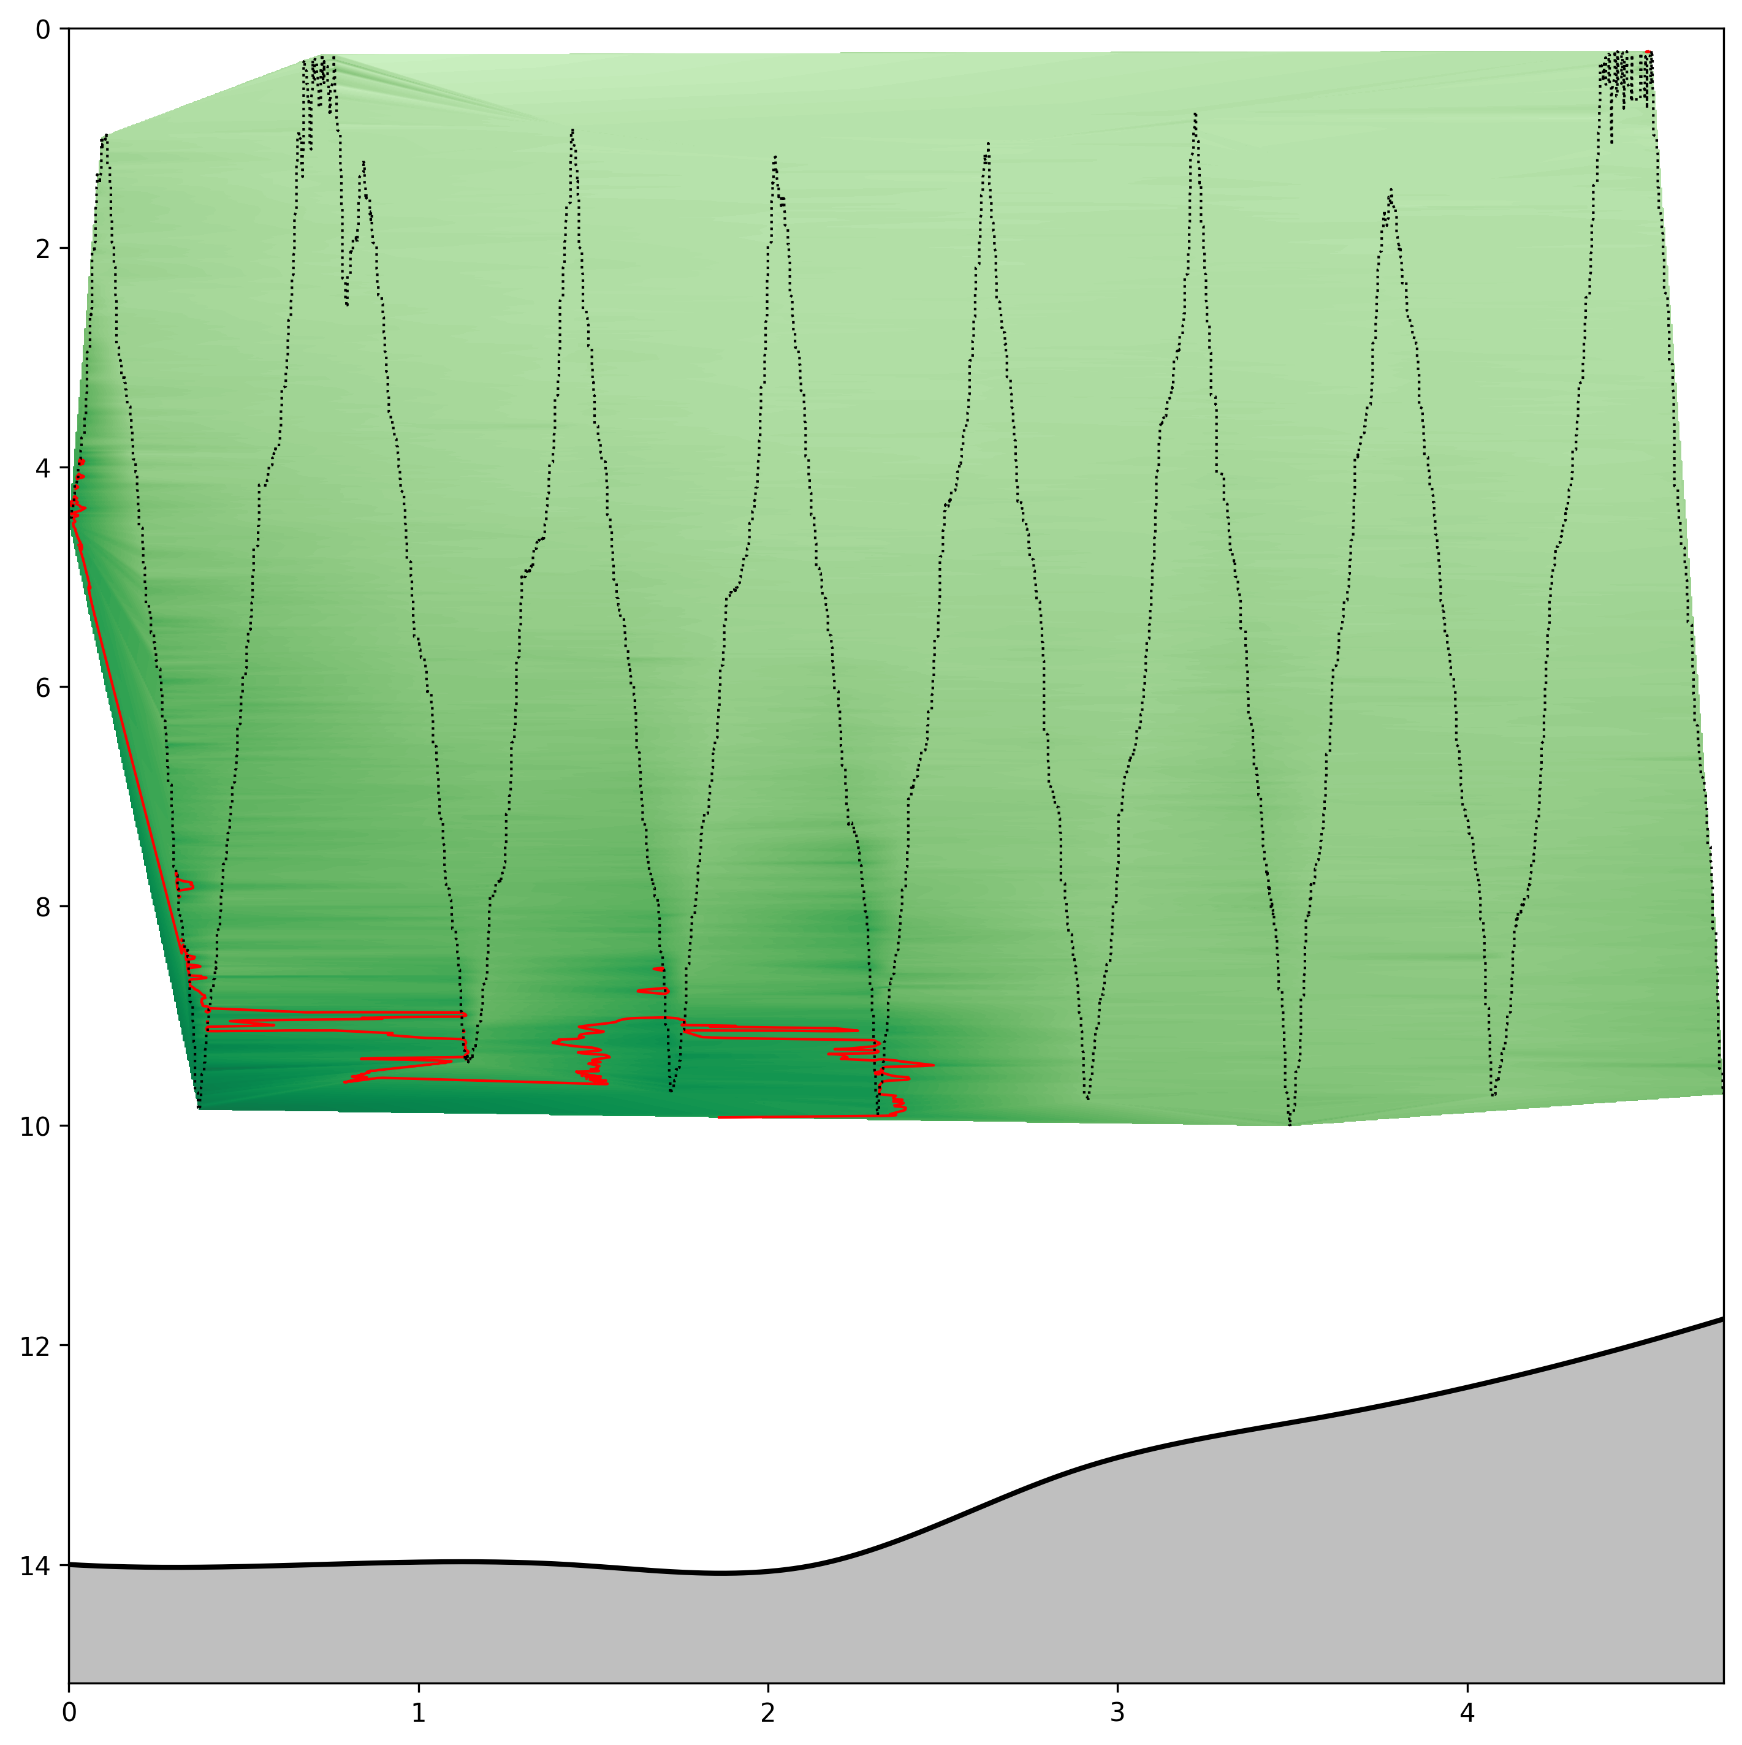
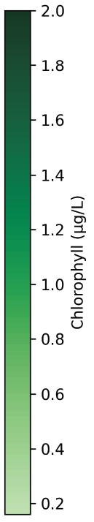
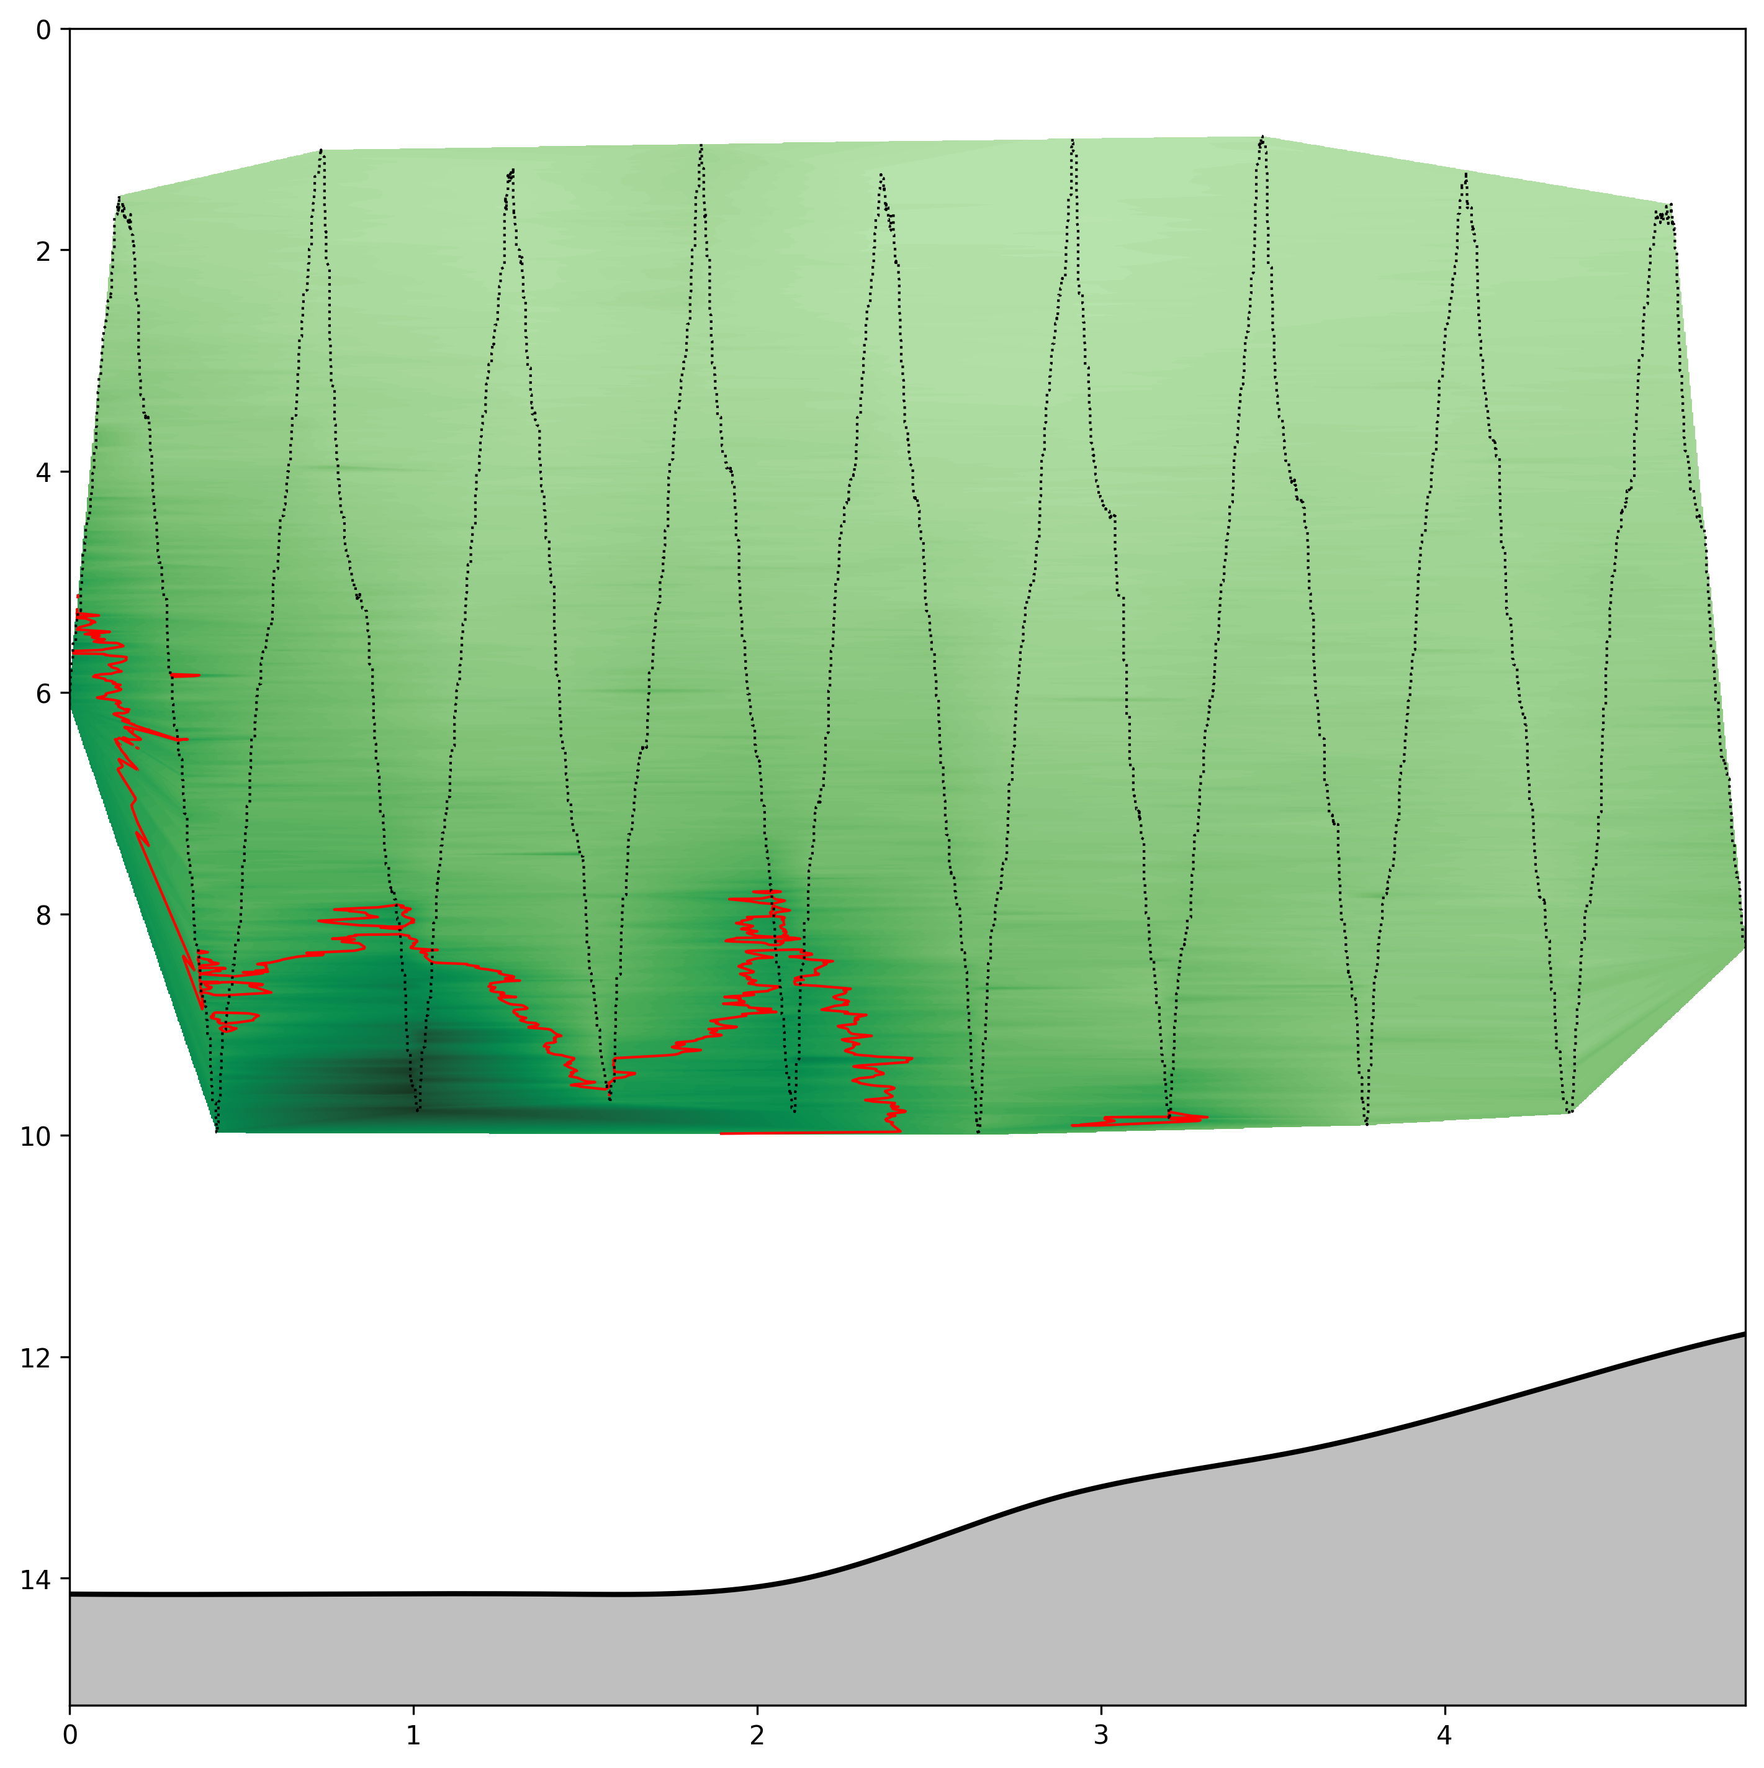
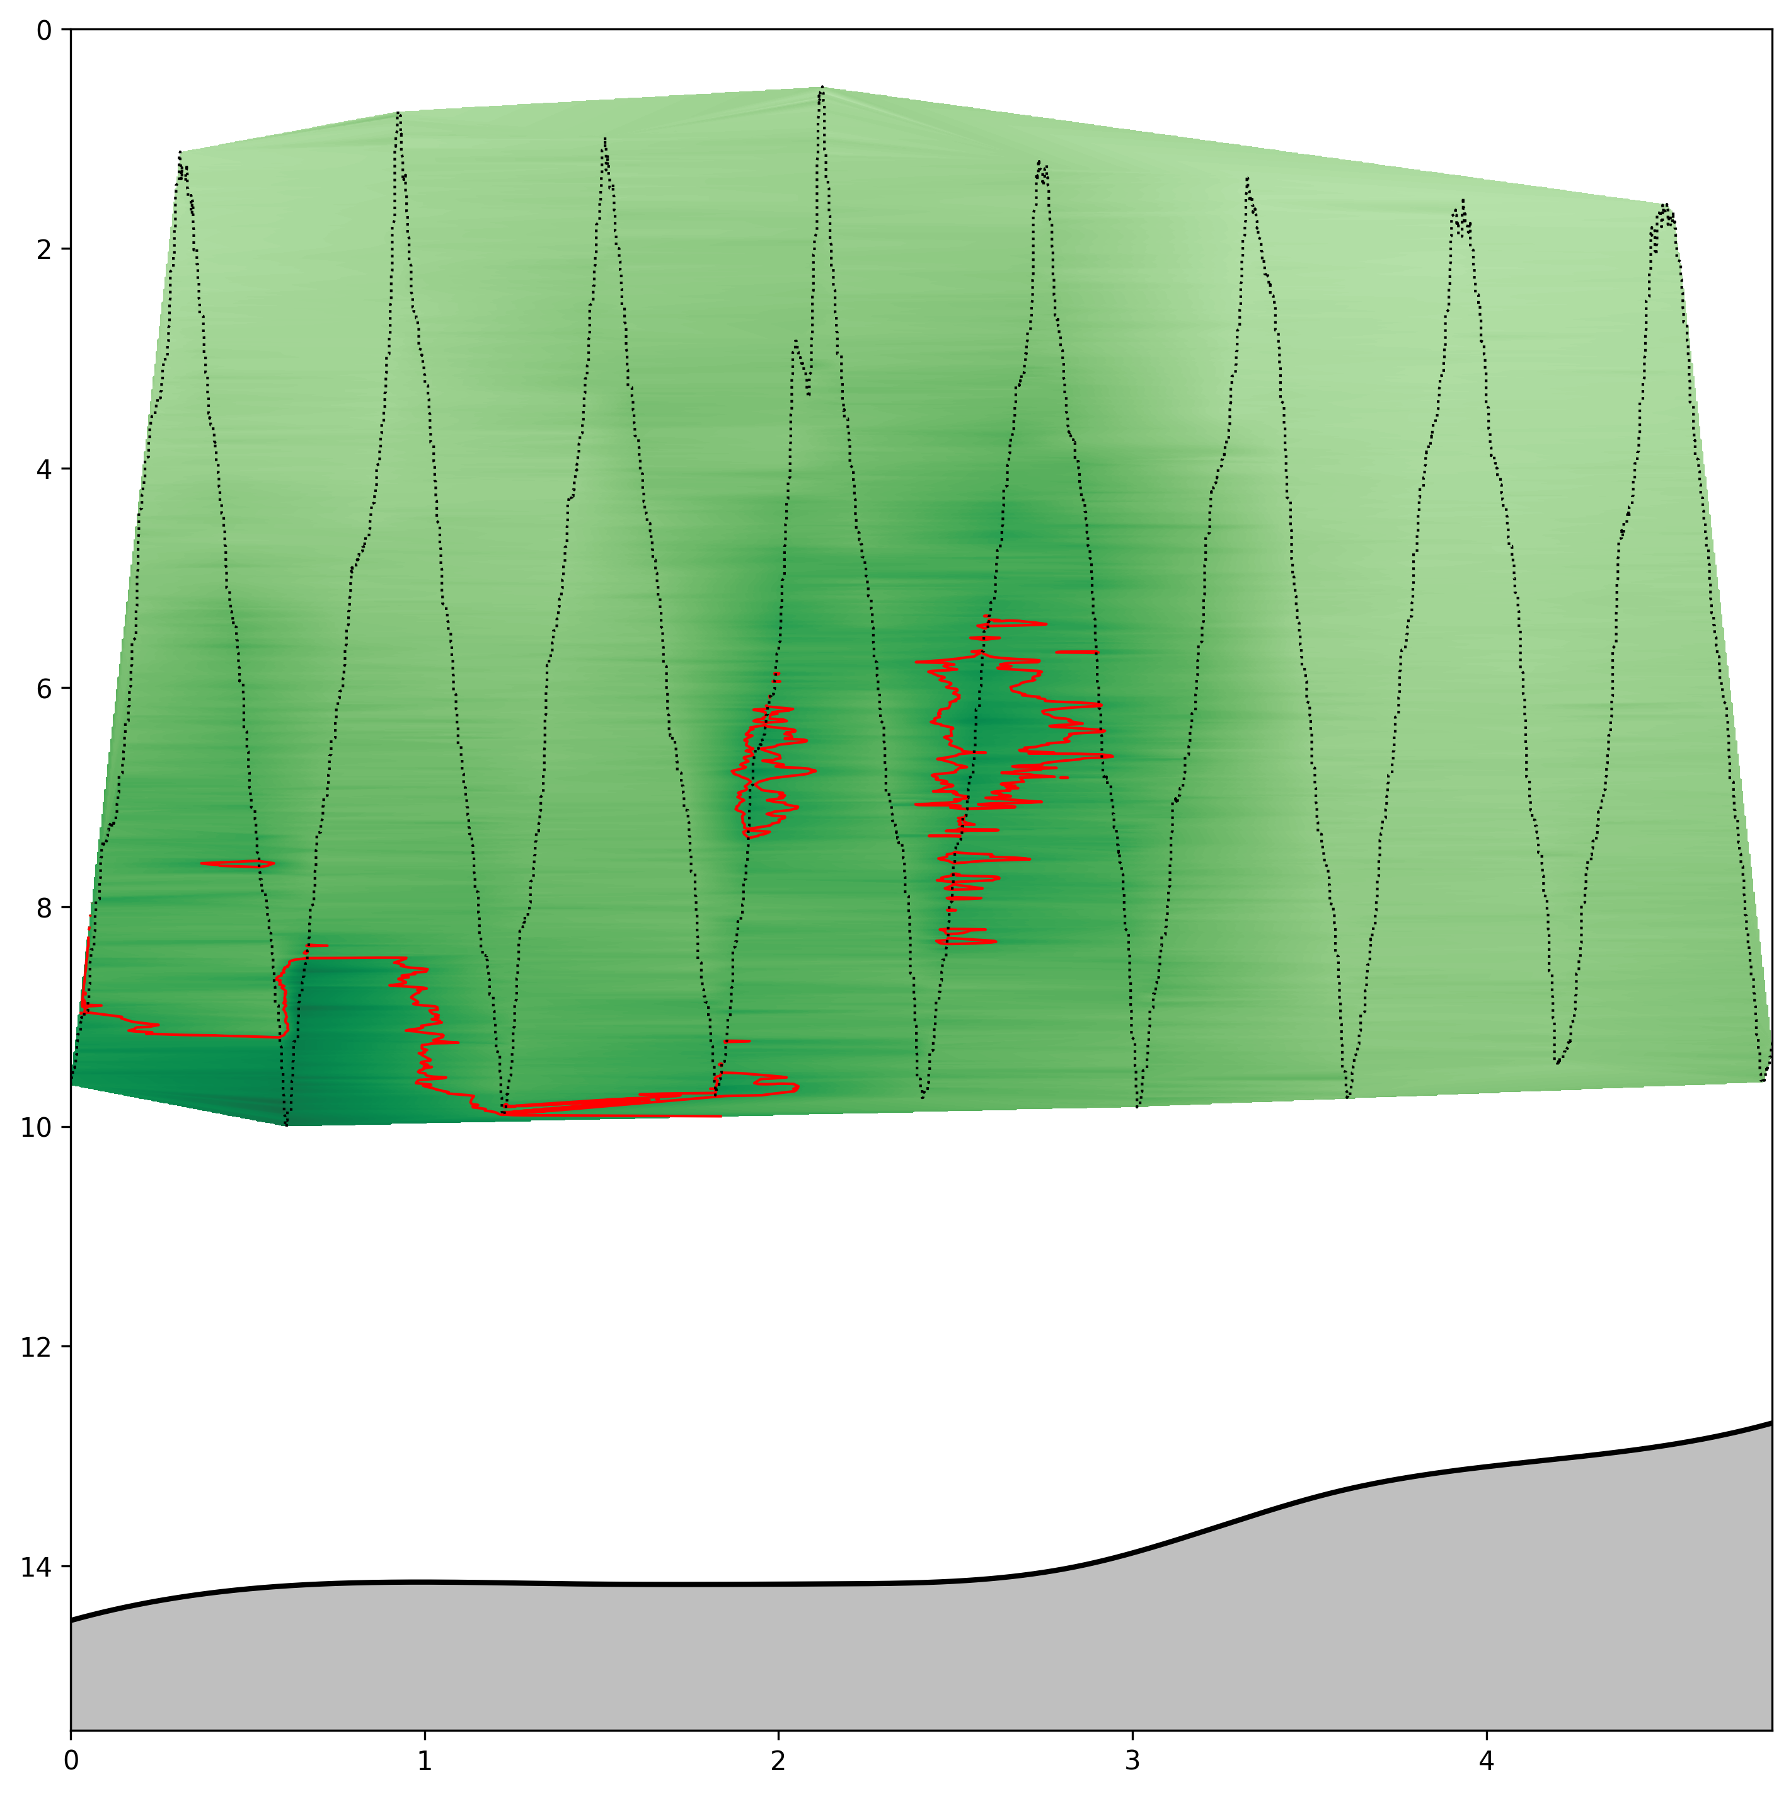
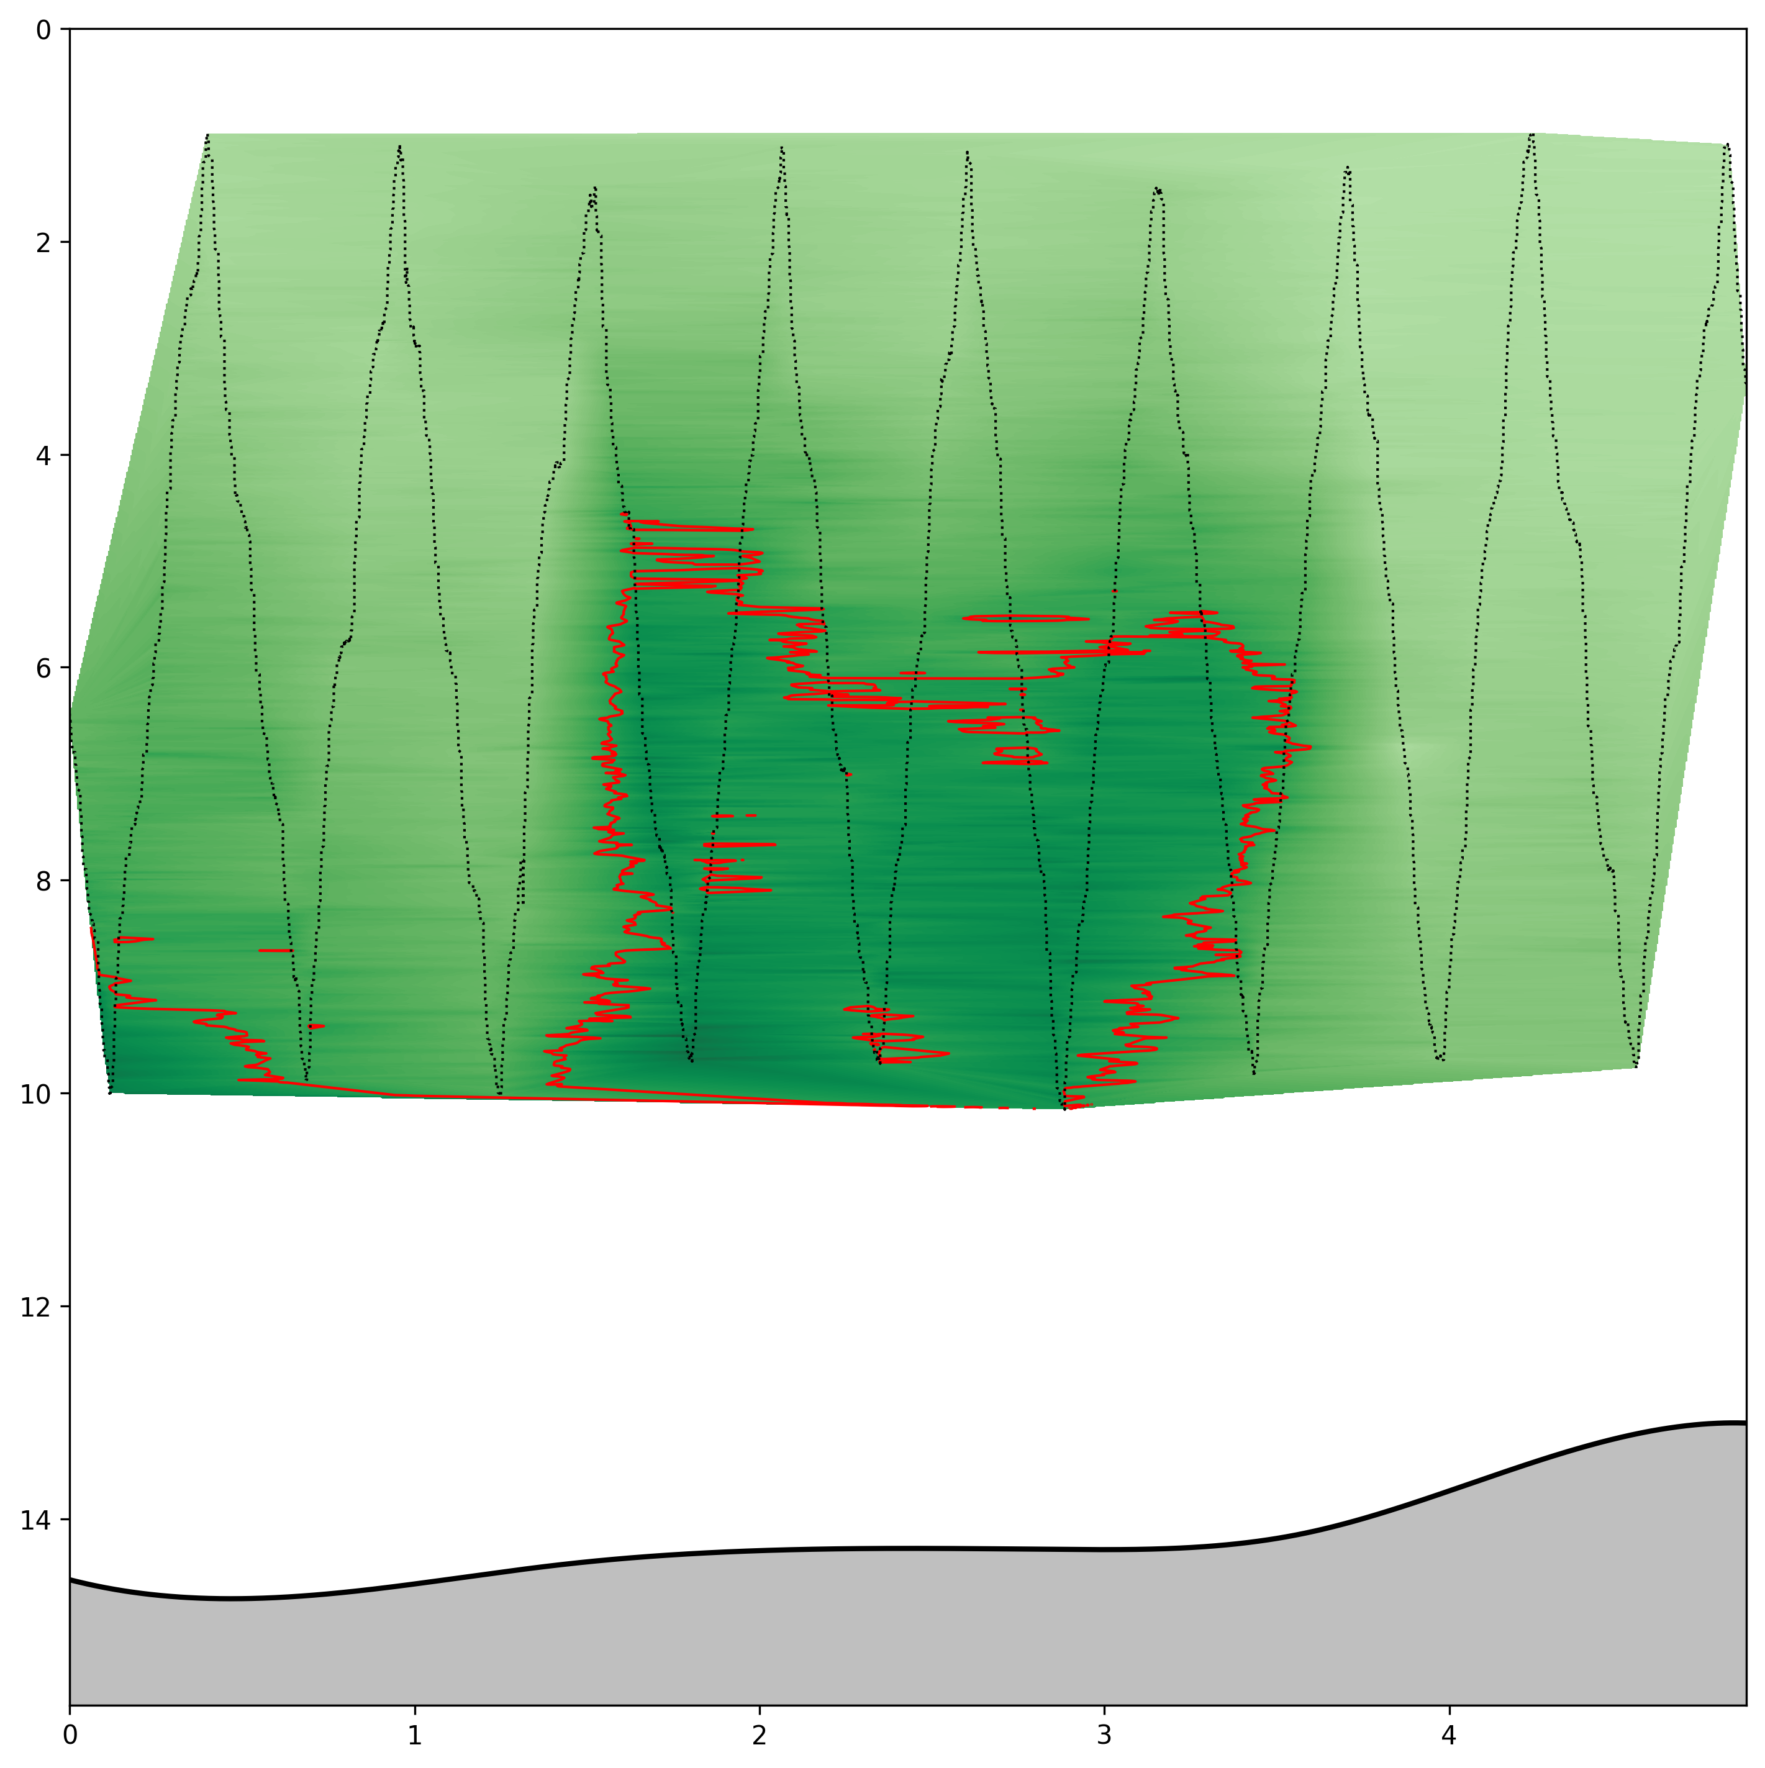
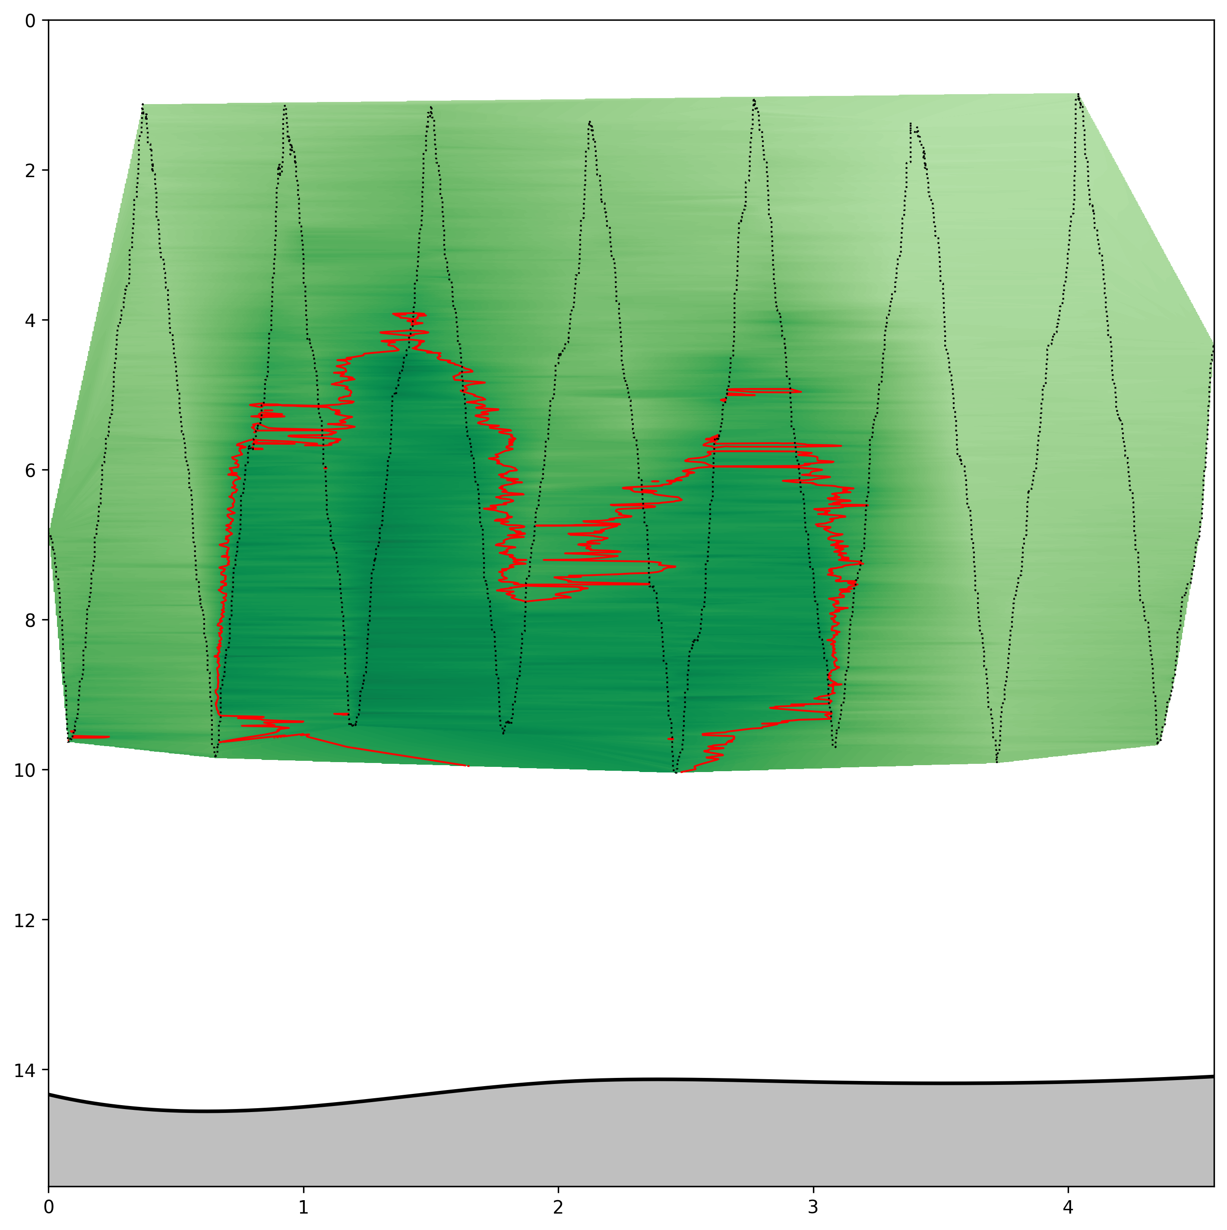

#1
#2
#3
Depth (m)
#4
#5
#6
#7
Distance along transect (km)

Slide 14
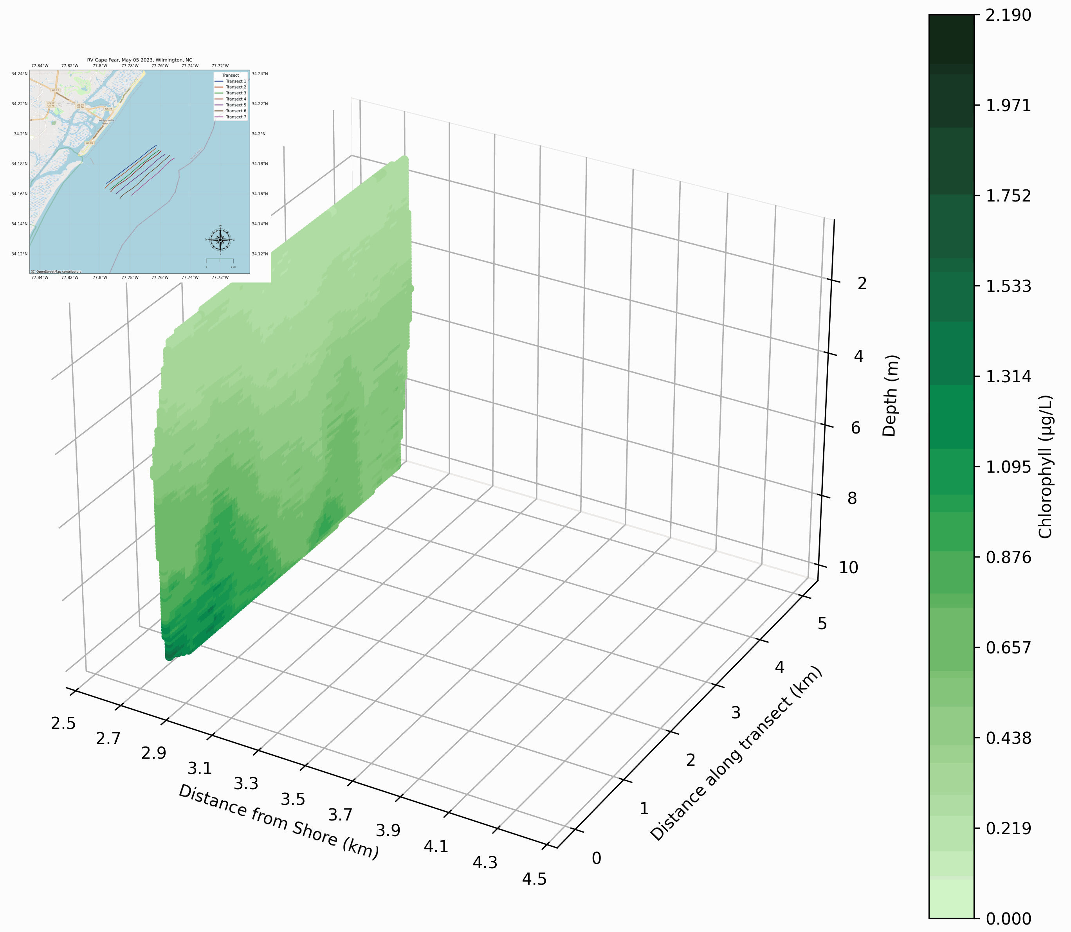

Slide 15
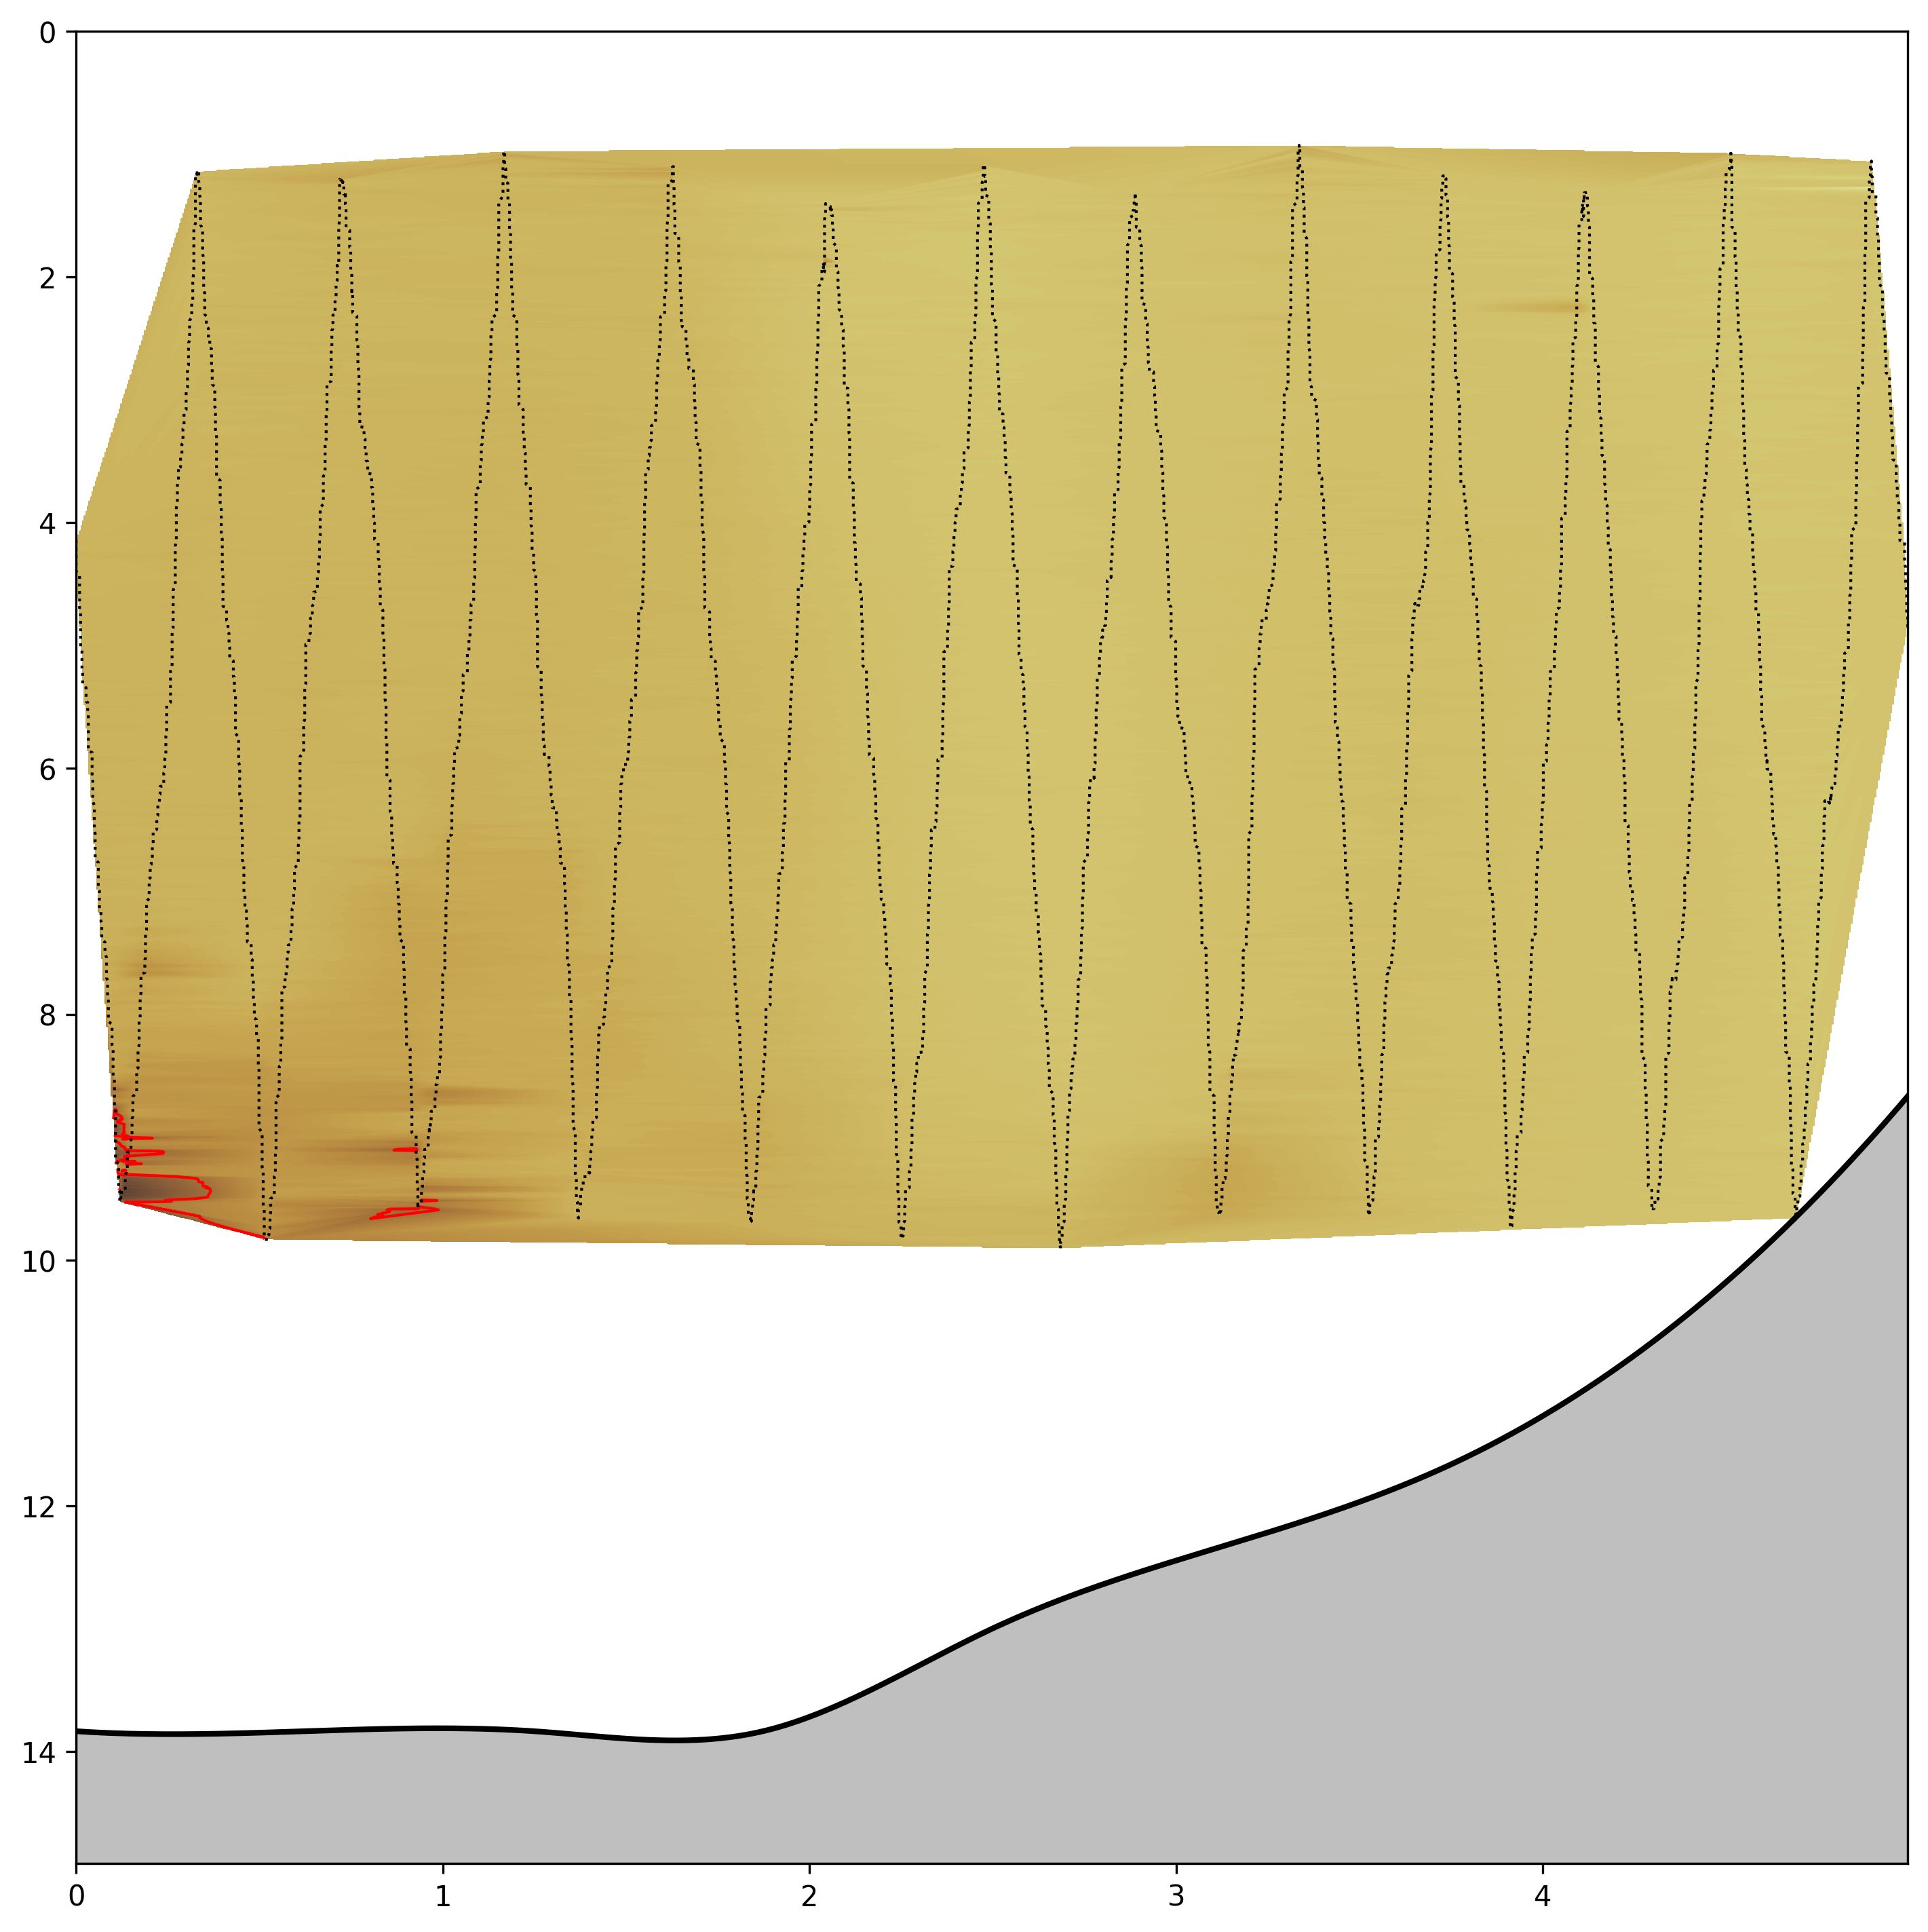
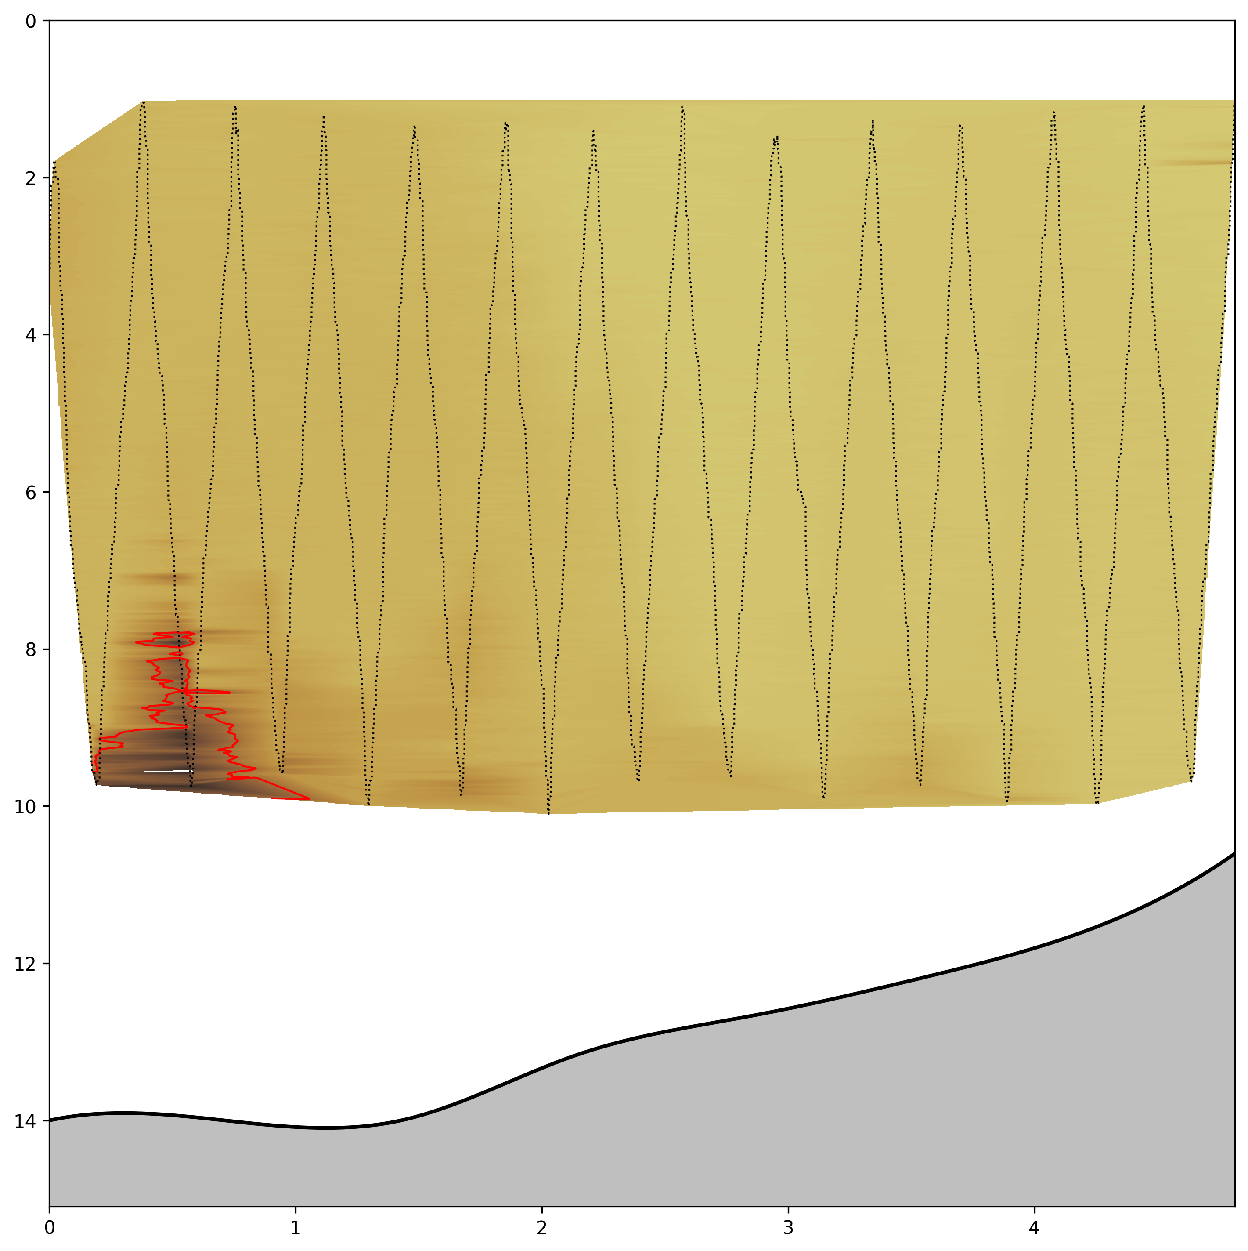
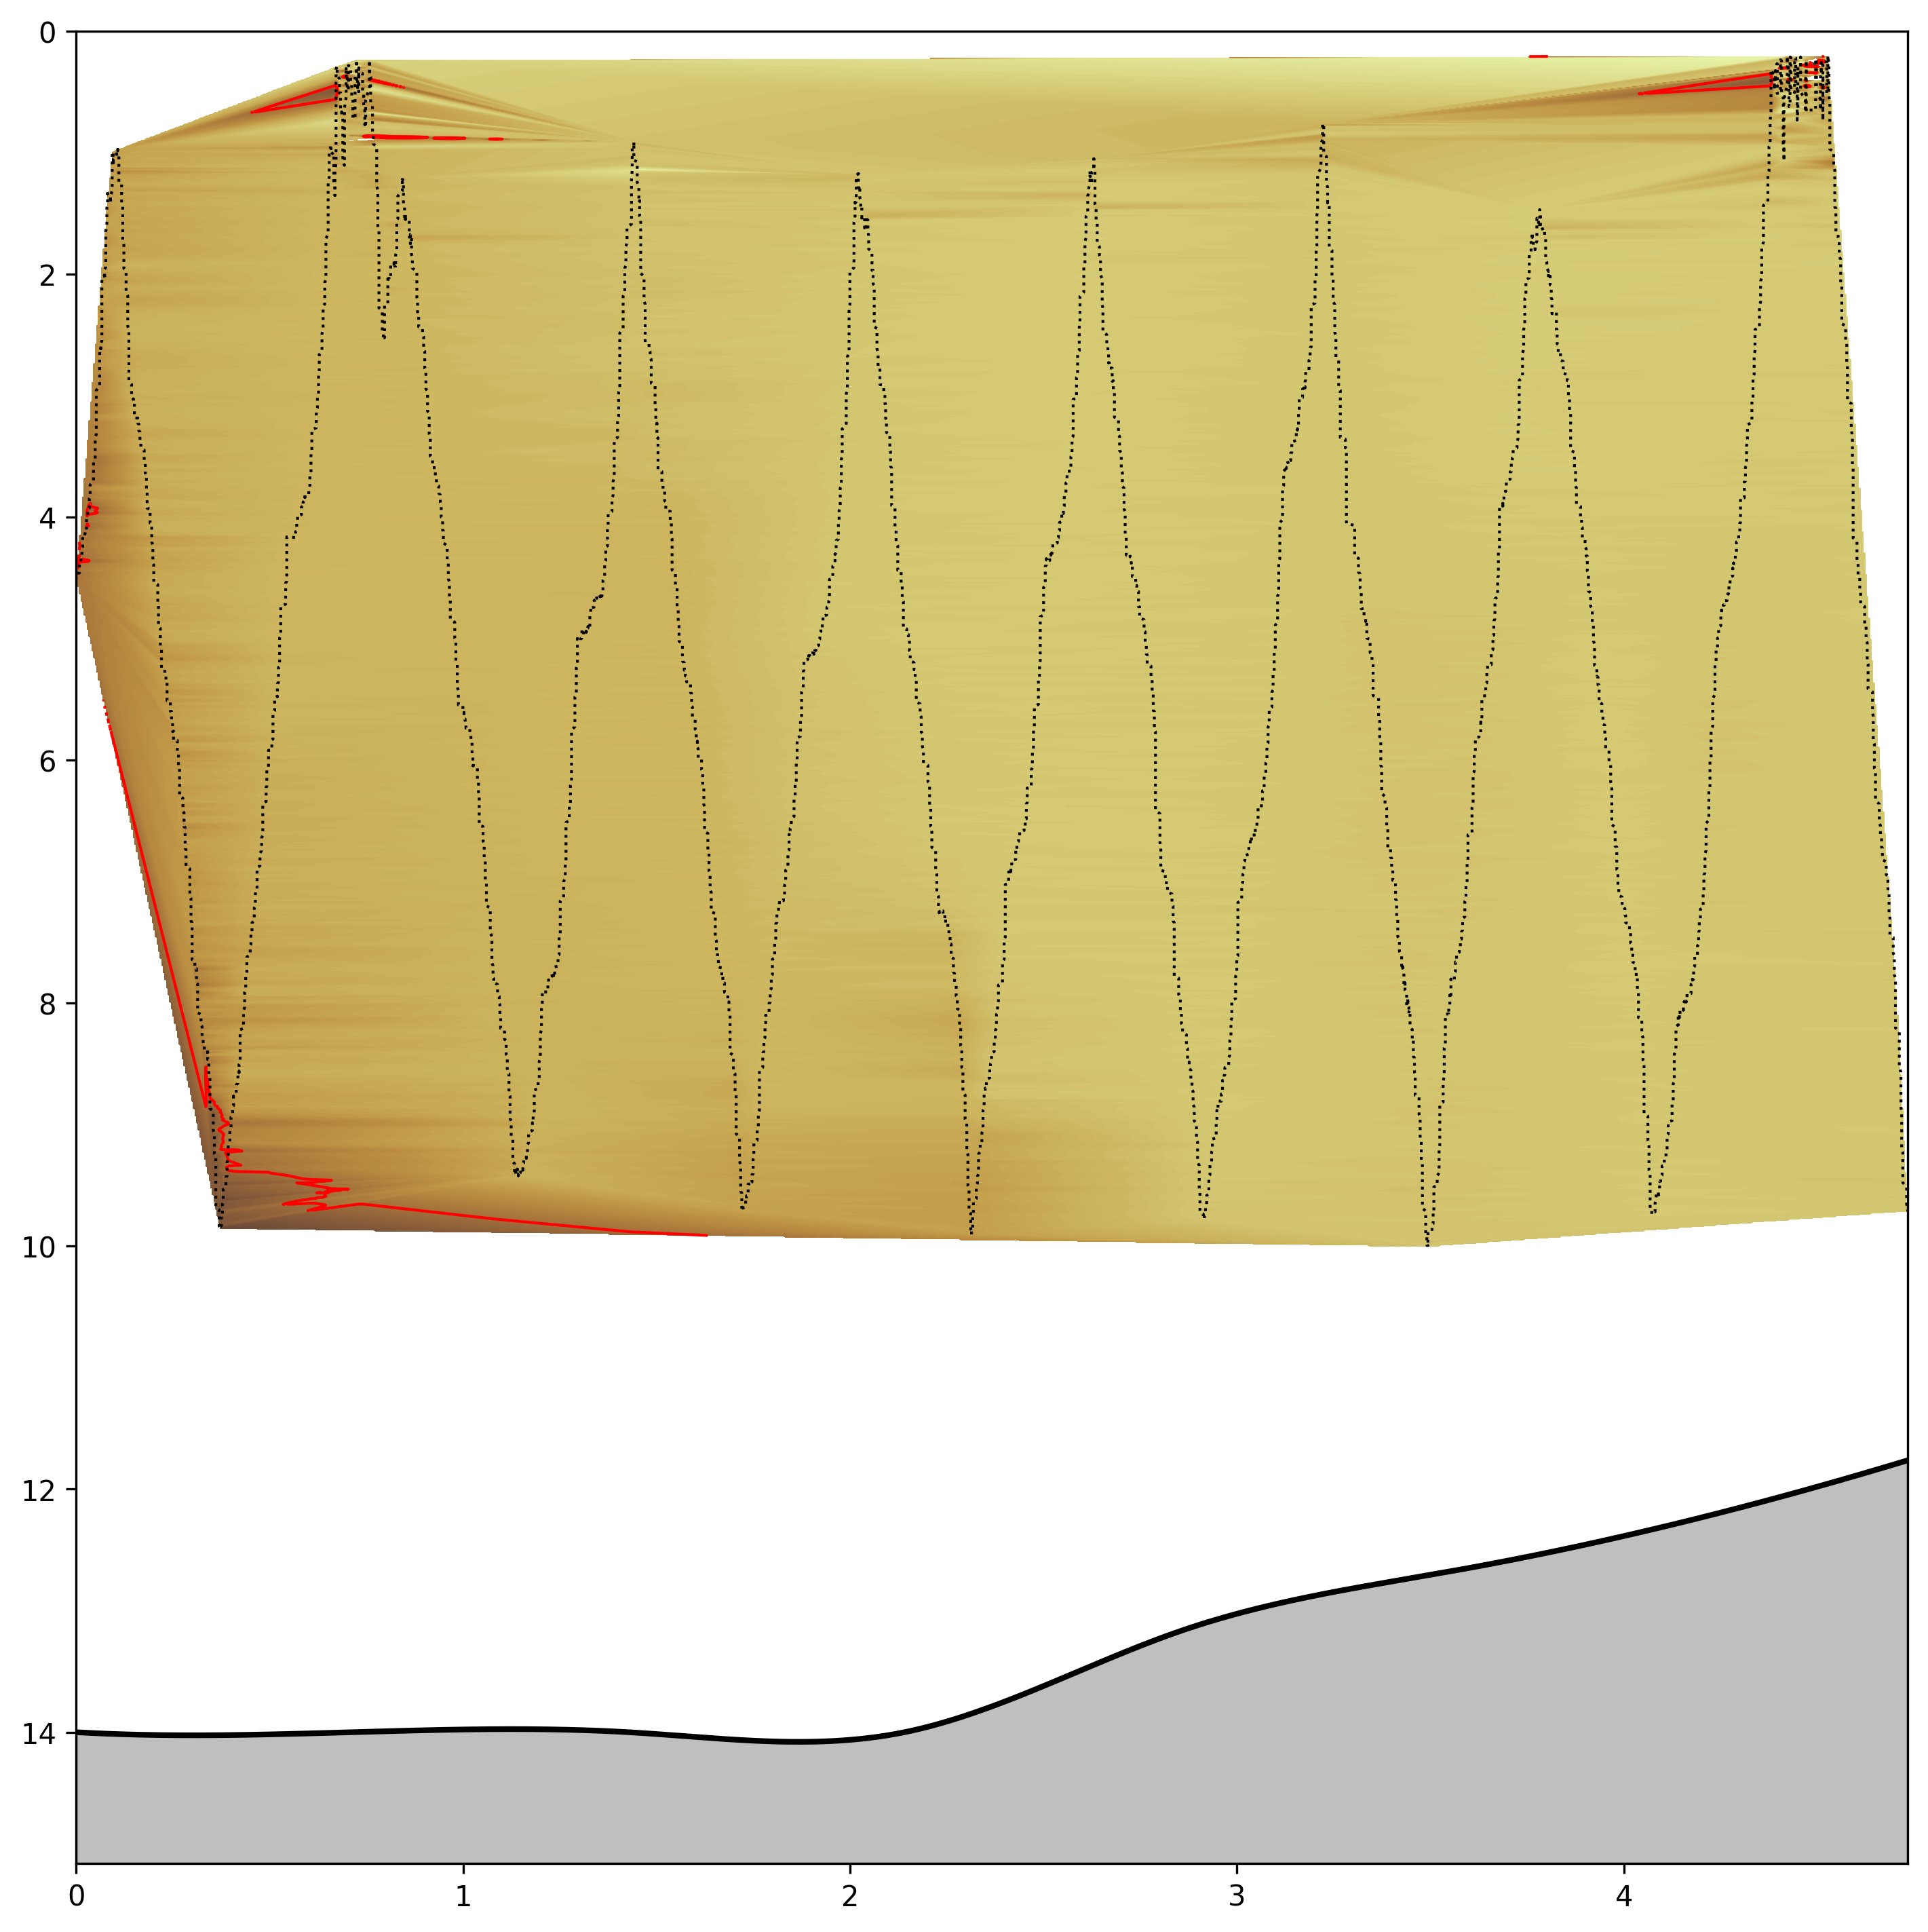
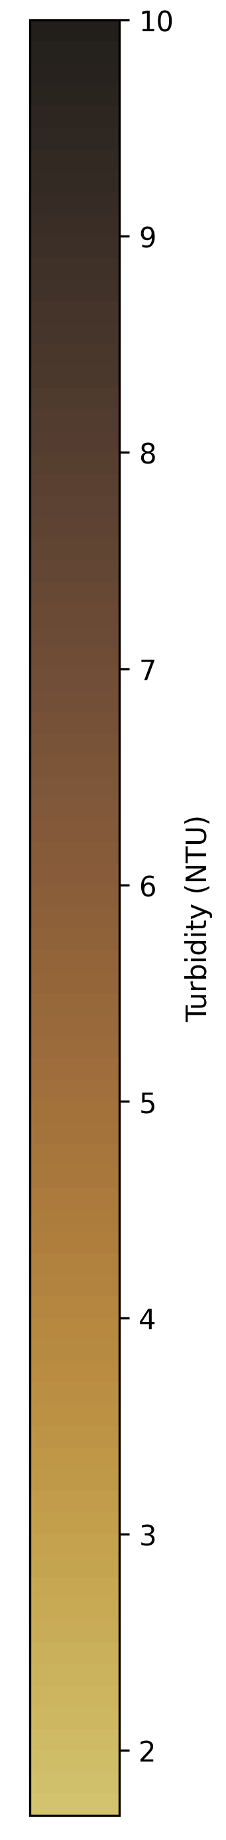
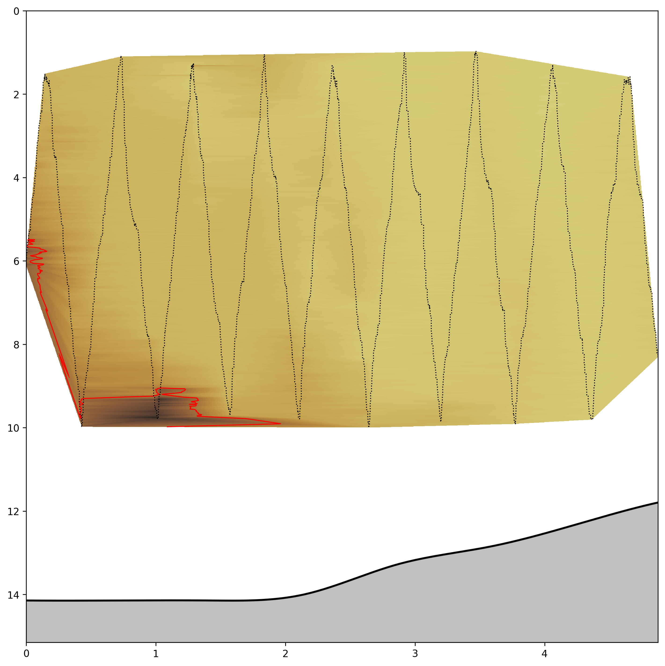
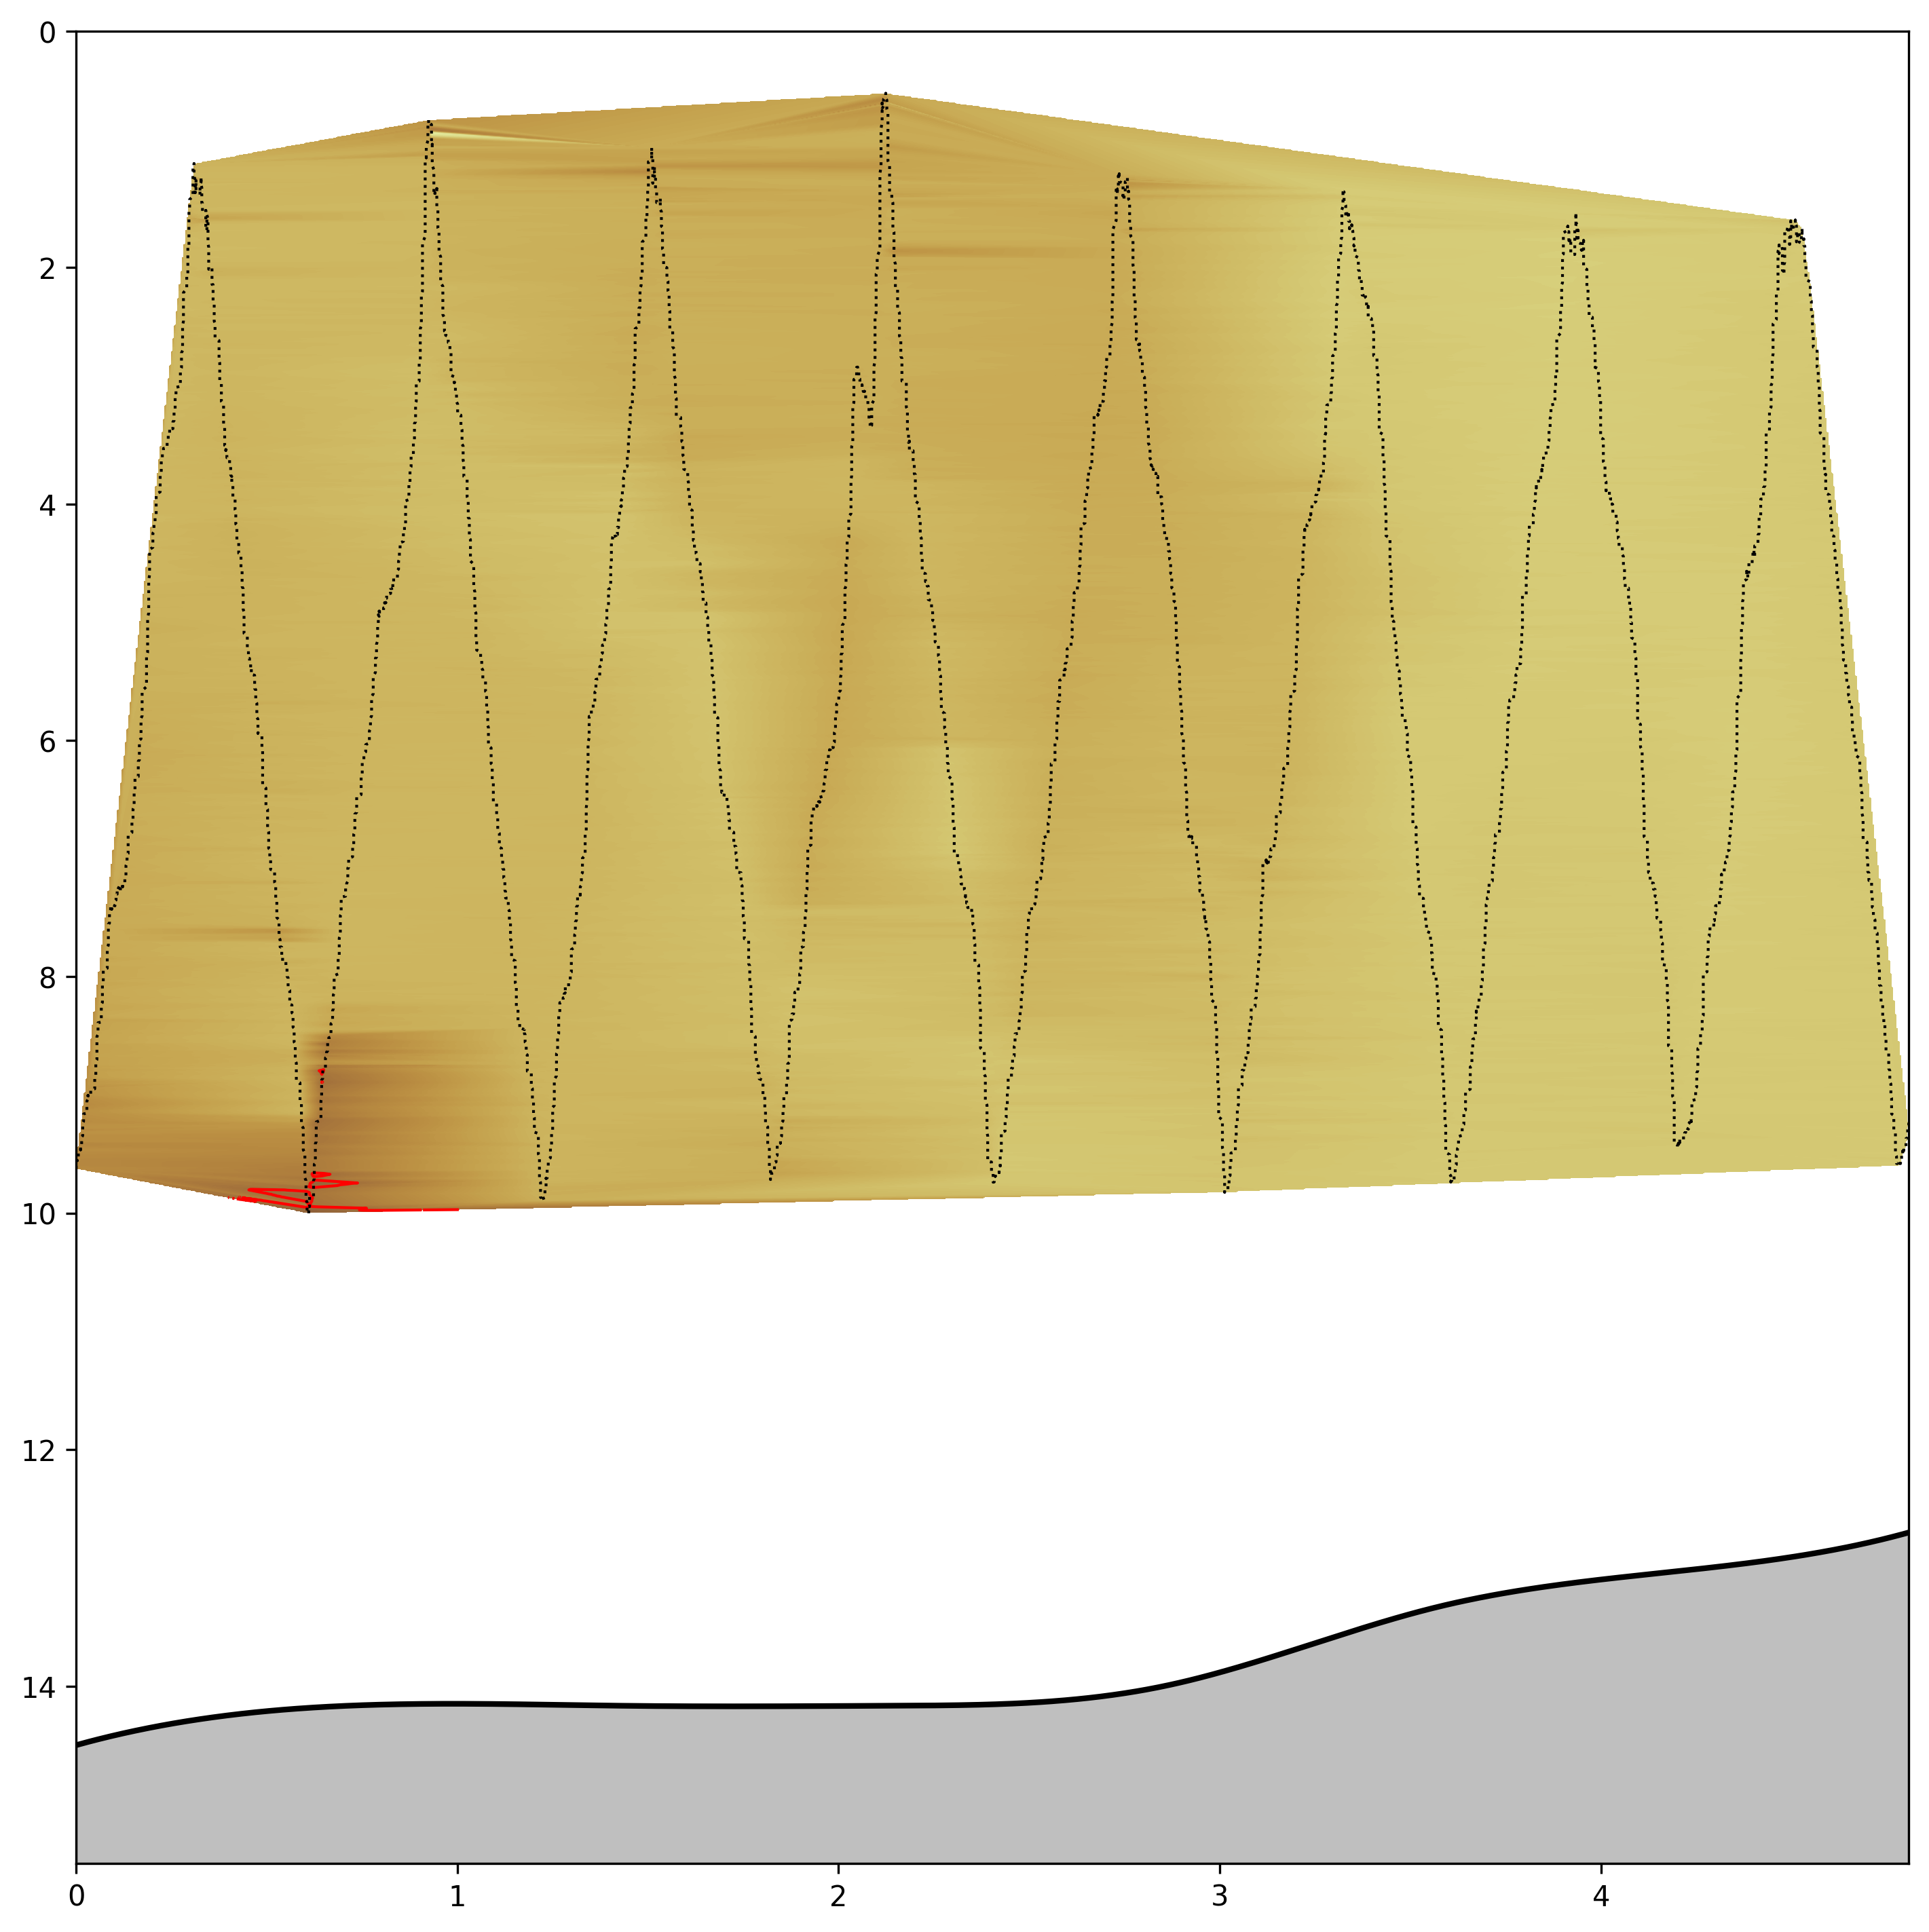
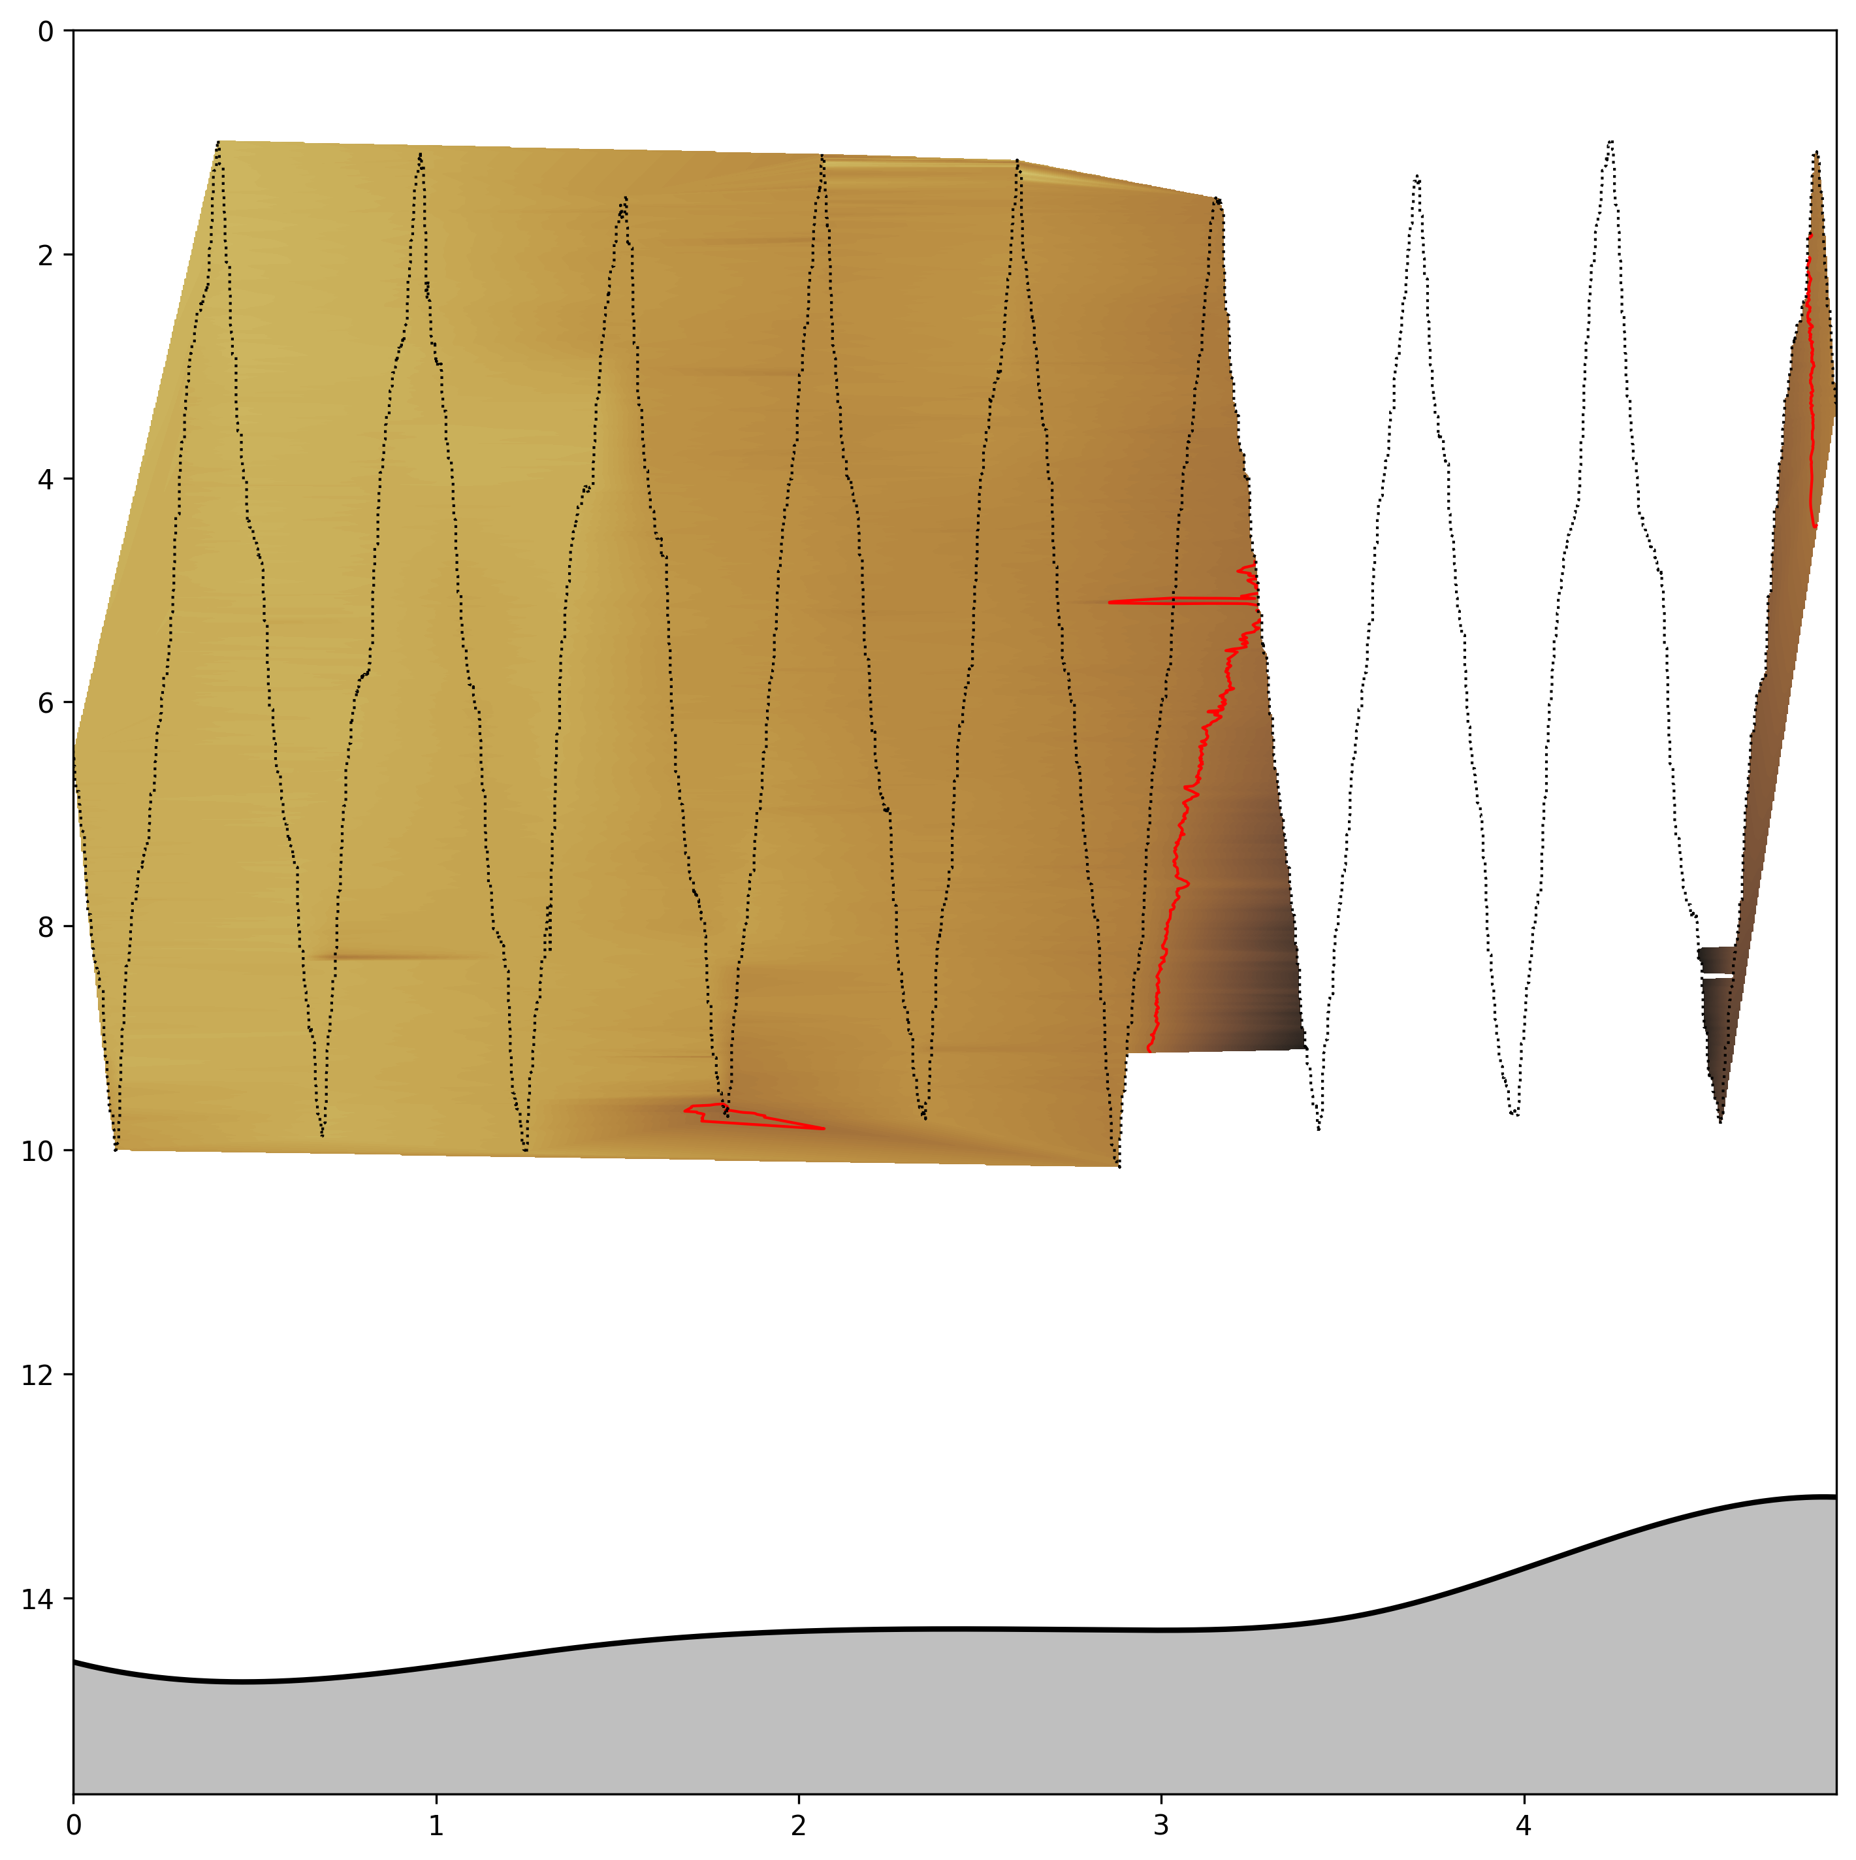
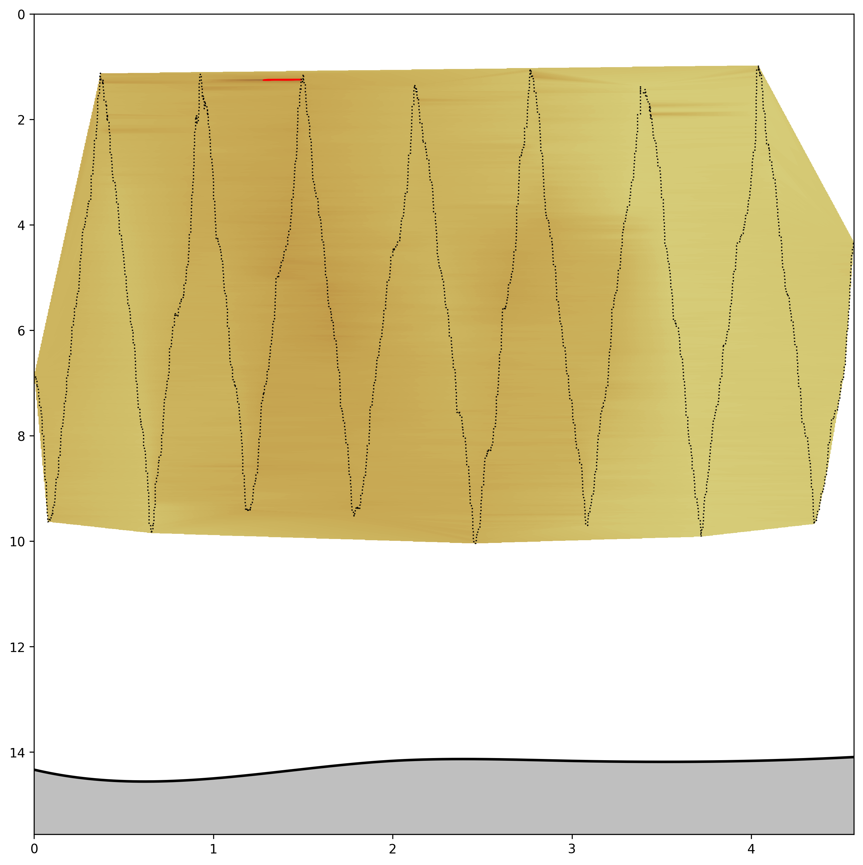
#1
#2
#3
Depth (m)
#4
#5
#6
#7
Distance along transect (km)
Turbidity > 5.0 NTU
Notes:
Logic for identifying ”outliers” in turbidity data:
We used predefined thresholds to flag data points as outliers.
Timing/Gap Test: This test checks if the time difference between consecutive data points exceeds a specified time increment. It flags data points that are too far apart in time, which might indicate missing or delayed measurements.
Gross Range Test: This test checks whether turbidity values fall within a specified range. Values outside this range are flagged as outliers.
Spike Test: this test identifies significant spikes in turbidity, which might indicate measurement errors or real but extraordinary changes in water conditions.
The flags raised by these tests don’t remove the data points but marks them by replacing the turbidity value with NaN.
We performed a statistical analysis on the entire dataset to define appropriate QC thresholds. We calculated statistical metrics like mean, median, standard deviation, and percentiles of the turbidity data, which helped to understand the typical range and variation of the turbidity measurements. The basic statistics for the turbidity data form the dataset are as follows:
Count: 83,091 (total number of turbidity measurements)
Mean: 4.759 (average turbidity)
Standard Deviation: 15.085 (variation in turbidity measurements)
Minimum: 0.000 (lowest recorded turbidity)
25th Percentile: 1.698 (25% of measurements are below this value)
Median (50th Percentile): 2.188 (half of the measurements are below this value)
75th Percentile: 2.562 (75% of measurements are below this value)
Maximum: 124.105 (highest recorded turbidity)
Considering the data, a reasonable range for the Gross Range Test might be bit wider than the 25th to 75th percentile range to accommodate natural variability. Therefore, we set the range from 0 to 10. We chose 5 as the threshold for significant changes in turbidity for the Spike Test.
The python script aligns with QARTOD guidelines since QARTOD recommends tests for checking timeliness and regularity of data points, tests for checking whether the data falls within expected physical/operational ranges, and tests for identifying measurements that exhibit abrupt changes that are unlikely to be physical phenomena.
Manual for real-time quality control of high frequency radar surface ... (n.d.). https://cdn.ioos.noaa.gov/media/2022/07/HFR_QARTOD_Manual_Update_Final-1b.pdf

Slide 16
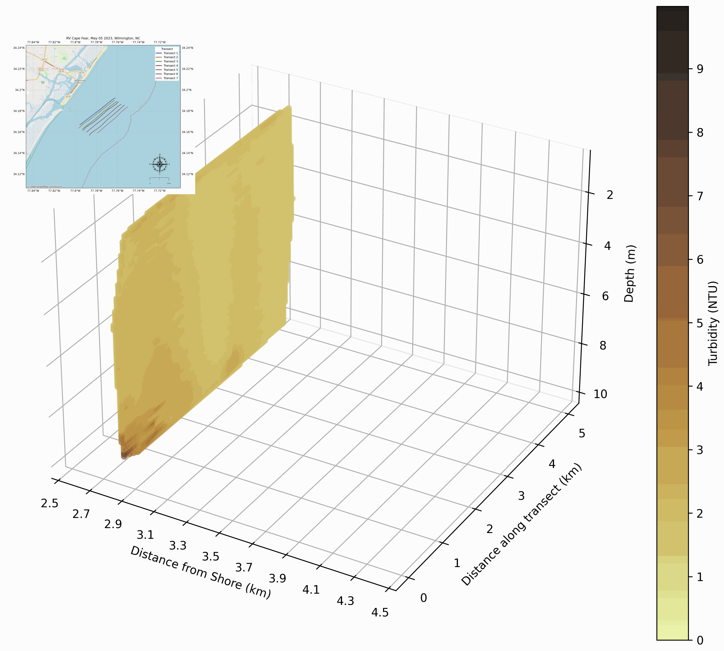

Slide 17
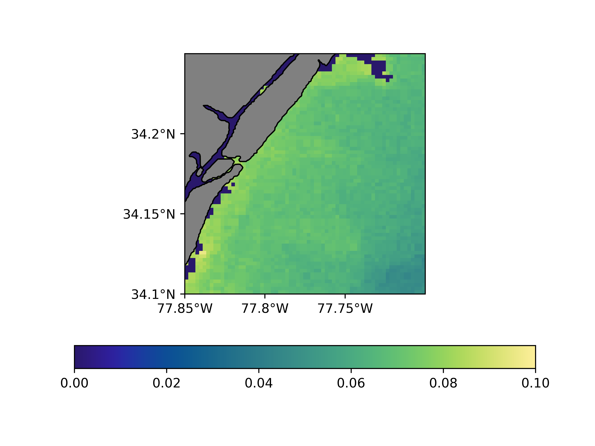
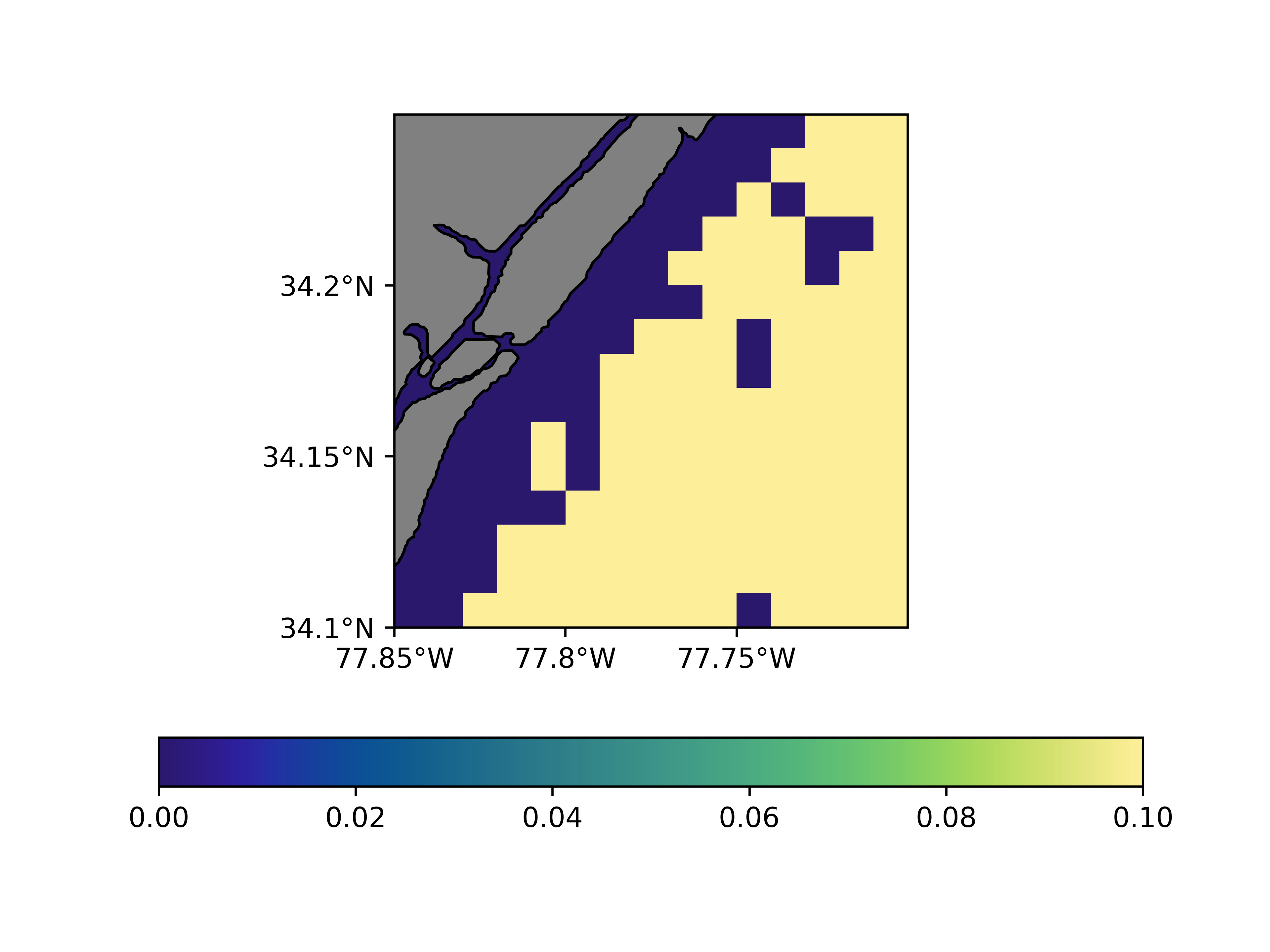
HawkEye – May 7, 2023
MODIS-Aqua – May 7, 2023
Kd_490 (1/m)
Notes:
Kd490 is the diffuse attenuation coefficient at 490 nm. This metric indicates the turbidity of the water column and thus, its clarity. The value of Kd490 represents the rate at which light at 490 nm is attenuated with depth. For example, a Kd490 of 0.1 /m means that light will be reduced one natural log within 10 meters of the water column. Higher Kd490 values mean shallower attenuation depth and lower clarity of ocean water.
HawkEye indicates a range of 0.06-0.1 1/m. the inverse of Kd, 1/Kd, is generally considered the first optical depth (roughly corresponding to the 37% light level). This translates to a first optical depth measurement of 10-12.5 m. Our in-situ measurements are conducted at depths of 10 m or shallower roughly. The total water depth in our study region is approximately 10-15 m. Given this, the depicted Chl concentrations are believed to be within the first optical depth of the coastal euphotic zone. However, its important to acknowledge that one optical depth may not be sufficient to prevent contamination of Rrs by benthic reflectance.
“Attenuate” = reduce the value of.

Slide 18
References
Barbier, E. B. (2014). The Protective Value Of Estuarine And Coastal Ecosystems. Handbook On The Economics Of Ecosystem Services And Biodiversity. Https://Doi.Org/10.4337/9781781951514.00008
Behrenfeld, M. J., & Falkowski, P. G. (1997). Photosynthetic Rates Derived From Satellite-Based Chlorophyll Concentration. Limnology And Oceanography, 42(1), 1–20. Https://Doi.Org/10.4319/Lo.1997.42.1.0001
Belkin, I. M. (2021). Remote Sensing Of Ocean Fronts In Marine Ecology And Fisheries. Remote Sensing, 13(5), 883. Https://Doi.Org/10.3390/Rs13050883
Carr, M.-E., Friedrichs, M. A. M., Schmeltz, M., Noguchi Aita, M., Antoine, D., Arrigo, K. R., Asanuma, I., Aumont, O., Barber, R., Behrenfeld, M., Bidigare, R., Buitenhuis, E. T., Campbell, J., Ciotti, A., Dierssen, H., Dowell, M., Dunne, J., Esaias, W., Gentili, B., … Yamanaka, Y. (2006). A Comparison Of Global Estimates Of Marine Primary Production From Ocean Color. Deep Sea Research Part Ii: Topical Studies In Oceanography, 53(5–7), 741–770. Https://Doi.Org/10.1016/J.Dsr2.2006.01.028
Dierssen, H. M., & Randolph, K. (2012). Remote Sensing Of Ocean Color. Encyclopedia Of Sustainability Science And Technology, 8952–8975. Https://Doi.Org/10.1007/Springerreference_310809
Field, C. B., Behrenfeld, M. J., Randerson, J. T., & Falkowski, P. (1998). Primary Production Of The Biosphere: Integrating Terrestrial And Oceanic Components. Science, 281(5374), 237–240. Https://Doi.Org/10.1126/Science.281.5374.237
Häder, D.-P., & Gao, K. (2015). Interactions Of Anthropogenic Stress Factors On Marine Phytoplankton. Frontiers In Environmental Science, 3. Https://Doi.Org/10.3389/Fenvs.2015.00014
Hoegh-Guldberg, O. Et Al. 2015. Reviving The Ocean Economy: The Case For Action - 2015. Wwf International, Gland, Switzerland., Geneva, 60 Pp.
Holmes, A., Feldman, G., Morrison, J., Patt, F., & Lee, S. (2018). Hawkeye Ocean Color Instrument: Performance Summary. Cubesats And Nanosats For Remote Sensing Ii. Https://Doi.Org/10.1117/12.2320654
Ioccg (2000) Remote Sensing Of Ocean Colour In Coastal, And Other Optically-Complex,Waters, (Ed. S. Sathyendranath). Dartmouth, Ns, Canada, International Ocean-Colour Coordinating Group (Ioccg), 140pp. (Reports Of The International Ocean-Colour Coordinating Group, No. 3) Doi: Http://Dx.Doi.Org/10.25607/Obp-95
Ioccg (2006) Remote Sensing Of Inherent Optical Properties: Fundamentals, Tests Of Algorithms, And Applications, (Ed. Z-P. Lee). Dartmouth, Ns, Canada, International Ocean-Colour Coordinating Group (Ioccg), 126pp. (Reports Of The International Ocean-Colour Coordinating Group, No. 5). Doi: Http://Dx.Doi.Org/10.25607/Obp-96
Jeffrey, H., Gorter, H., Gow, A., Clark, C., Holmes, A., Herrin, C., Sasaki, L., & Morrison, J. (2018). Seahawk: A Nanosatellite Mission For Sustained Ocean Observation. Proceedings Of The 13th Reinventing Space Conference, 83–93. Https://Doi.Org/10.1007/978-3-319-32817-1_9
Loisel, H., Vantrepotte, V., Jamet, C., & Ngoc Dat, D. (2013b). Challenges And New Advances In Ocean Color Remote Sensing Of Coastal Waters. Topics In Oceanography. Https://Doi.Org/10.5772/56414
Macreadie, P. I., Anton, A., Raven, J. A., Beaumont, N., Connolly, R. M., Friess, D. A., Kelleway, J. J., Kennedy, H., Kuwae, T., Lavery, P. S., Lovelock, C. E., Smale, D. A., Apostolaki, E. T., Atwood, T. B., Baldock, J., Bianchi, T. S., Chmura, G. L., Eyre, B. D., Fourqurean, J. W., … Duarte, C. M. (2019). The Future Of Blue Carbon Science. Nature Communications, 10(1). Https://Doi.Org/10.1038/S41467-019-11693-W
Mcleod, E., Chmura, G. L., Bouillon, S., Salm, R., Björk, M., Duarte, C. M., Lovelock, C. E., Schlesinger, W. H., & Silliman, B. R. (2011). A Blueprint For Blue Carbon: Toward An Improved Understanding Of The Role Of Vegetated Coastal Habitats In Sequestering Co2. Frontiers In Ecology And The Environment, 9(10), 552–560. Https://Doi.Org/10.1890/110004
Nagelkerken, I., Sheaves, M., Baker, R., & Connolly, R. M. (2013). The Seascape Nursery: A Novel Spatial Approach To Identify And Manage Nurseries For Coastal Marine Fauna. Fish And Fisheries, 16(2), 362–371. Https://Doi.Org/10.1111/Faf.12057
O’reilly, J. E., & Werdell, P. J. (2019). Chlorophyll Algorithms For Ocean Color Sensors - Oc4, Oc5 & Oc6. Remote Sensing Of Environment, 229, 32–47. Https://Doi.Org/10.1016/J.Rse.2019.04.021 J. M. (2021, August 31). Seahawk mission proves CubeSats are a viable option for collecting credible scientific data. NASA. https://www.earthdata.nasa.gov/learn/articles/seahawk-hawkeye-ocean-color
Smith, R. C., & Baker, K. S. (1978). Optical Classification Of Natural Waters 1. Limnology And Oceanography, 23(2), 260–267. Https://Doi.Org/10.4319/Lo.1978.23.2.0260
Vanhellemont, Q., & Ruddick, K. (2014). Turbid Wakes Associated With Offshore Wind Turbines Observed With Landsat 8. Remote Sensing Of Environment, 145, 105–115. Https://Doi.Org/10.1016/J.Rse.2014.01.009

